Slide 1

Service-Oriented Architecture for Sharing Private Spatial-Temporal Data
Hani AbuSharkh
Benjamin C. M. Fung
fung (at) ciise.concordia.ca
Concordia Institute for Information Systems Engineering
Concordia University
Montreal, Canada
IEEE CSC 2011
The research is supported in part by the Discovery Grants (356065-2008) from Natural Sciences and Engineering Research Council of Canada (NSERC).
Notes:
IEEE CSC 2011

Slide 2

Agenda
Motivating Scenario
Problem Description
Service Oriented Architecture
Anonymization Algorithm
Empirical Study
Related Works
Summary and Conclusion
1

Slide 3

Motivating Scenario
Passengers use personal rechargeable smart/RFID card for their travel.
Transit companies want to share passengers’ trajectory information to third party for analysis. The data may contain person-specific sensitive information, such as age, disability status, and employment status.
How can the transit company safeguard data privacy while keeping the released spatial-temporal data useful?
Source: http://www.stl.laval.qc.ca/

Slide 4
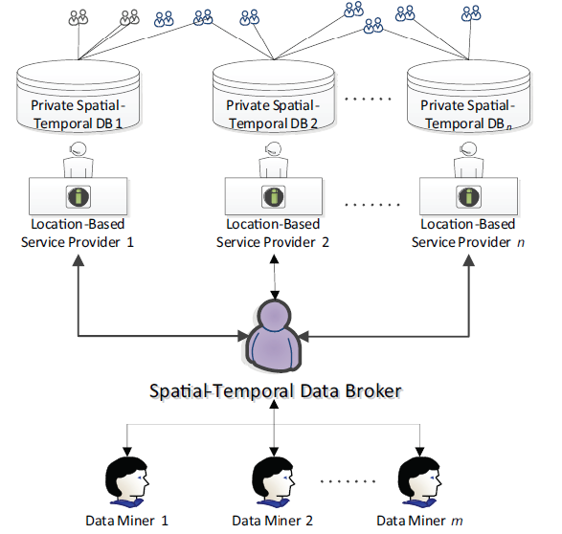
The Two Problems
How can a data miner identify an appropriate service provider(s)?
How can the service providers share their private data without compromising the privacy of its clients and the information utility for data mining?
3

Slide 5
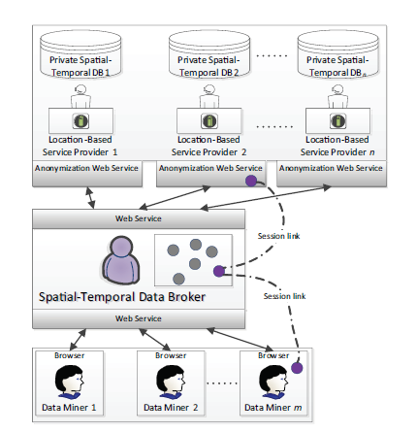
Service-Oriented Architecture
Fetch DB schema
Authenticate data miner
Identify contributing data providers
Initialize session
Negotiate requirements
Anonymize data
Share data
7

Slide 6
Raw Data
Spatial-Temporal Data Table
<EPC#; loc; time>
<EPC1; a; t1>
<EPC2; b; t1>
<EPC3; c; t2>
<EPC2; d; t2>
<EPC1; e; t2>
<EPC3; e; t4>
<EPC1; c; t3>
<EPC2; f; t3>
<EPC1; g; t4>
 | Path
EPC1 EPC2 EPC3 | < a1→ e2 → c3 → g4 > < b1 → d2 → f3 > < c2 → e4 >
Person-Specific Data
[EPC1, Full-time]
[EPC2, Part-time]
[EPC3, On-welfare]
7

Slide 7
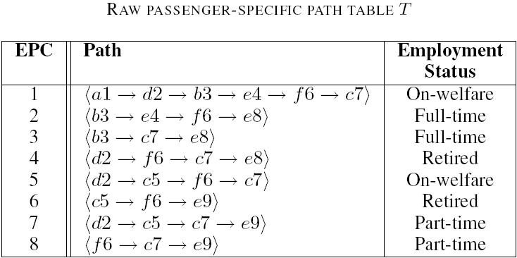
Spatial-Temporal Data Table
<(loc₁t₁) →…→ (loc_{n}t_{n})> : s₁,…,s_{p}
where
(loc_{i}t_{i}) is a doublet indicating the location and time,
<(loc₁t₁) →…→ (loc_{n}t_{n})> is a path, and
s₁,…,s_{p} are sensitive values.
12

Slide 8
Privacy Threats: Record Linkage
Assumption: an adversary knows at most L doublets about a target victim. L represents the power of the adversary.
q = <d2→f6>, G(q) = {EPC#1,4,5}
q = <e4→c7>, G(q) = {EPC#1}
A table T satisfies LK-anonymity if and only if |G(q)| ≥ K for any subsequence q with |q| ≤ L of any path in T, where G(q) is the set of records containing q and K is an anonymity threshold.
22

Slide 9
Privacy Threats: Attribute Linkage
q = <d2→f6>, G(q) = {EPC#1,4,5}
Let S be a set of data holder-specified sensitive values.
A table T satisfies LC-dilution if and only if Conf(s|G(q)) ≤ C for any s ∈ S and for any subsequence q with |q| ≤ L of any path in T, where Conf(s|G(q)) is the percentage of the records in G(q) containing s and C ≤ 1 is a confidence threshold.
24

Slide 10
LKC-Privacy Model
A spatial-temporal data table T satisfies LKC-privacy if T satisfies both LK-anonymity and LC-dilution
Privacy guarantee: LKC-privacy bounds
  probability of a successful record linkage is ≤ 1/K and
  probability of a successful attribute linkage is ≤ C
given the adversary’s background knowledge is ≤ L.
25

Slide 11
Information Utility
q = <d2→c7>, G(q) = {EPC#1,4,5,7}
A sequence q is a frequent sequence if |G(q)| ≥ K′, where G(q) is the set of records in T containing q and K′ is a minimum support threshold.
10

Slide 12

Spatial-Temporal Anonymizer
ST-Anonymizer
1: Supp = ∅;
2: while |V(T)| > 0 do
3: Select a doublet d with the maximum Score(d);
4: Supp ← d;
5: Update Score(d′) if any sequence in V (T) or F(T) containing both d and d′;
6: end while
7: return Table T after suppressing doublets in Supp;
We suppress a doublet d of the highest score:
12
Notes:
A naïve approach: first enumerate all violating sequences then remove them → Not efficient

Slide 13
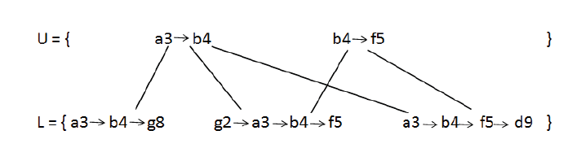
Border Representation
Violating Sequence (VS) border:
  UB contains minimal violating sequences.
  LB contains maximal sequences y with support |T(y)| ≥ 1.
Frequent Sequence (FS) border:
  UB contains doublets d with support |T(d)| ≥ max(K, K’).
  LB contains maximal sequences y with support |T(y)| ≥ K’
  where K is the anonymity threshold, and K’ is the minimum support threshold
14

Slide 14
Minimal Violating Sequence
A sequence q with length ≤ L is a violating sequence with respect to a LKC-privacy requirement if |G(q)| < K or Conf(s|G(q)) > C.
A violating sequence q is a minimal violating sequence if every proper subsequence of q is not a violating sequence.
27

Slide 15
Suppose L = 2 and K = 2.
<e4 → c7> is a minimal violating sequence because
  <e4> is not a violation and
  <c7> is not a violation.
28

Slide 16
Suppose L = 2 and K = 2.
<d2 → e4 → c7> is a violating sequence but not minimal because
  <e4 → c7> is a violating sequence.
28

Slide 17
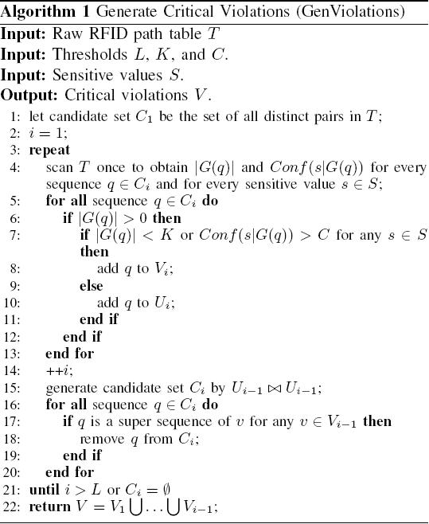
Intuition
Generate minimal violating sequences of size i+1 by incrementally extending non- violating sequences of size i with an additional doublet. [Mohammed et al. (2009)]
30

Slide 18




Counting Function
Consider a single edge ⟨x, y⟩ in a border. The equation below returns the number of sequences with maximum length L that are covered by ⟨x, y⟩ and are super sequences of a given sequence q.
Where:
15

Slide 19
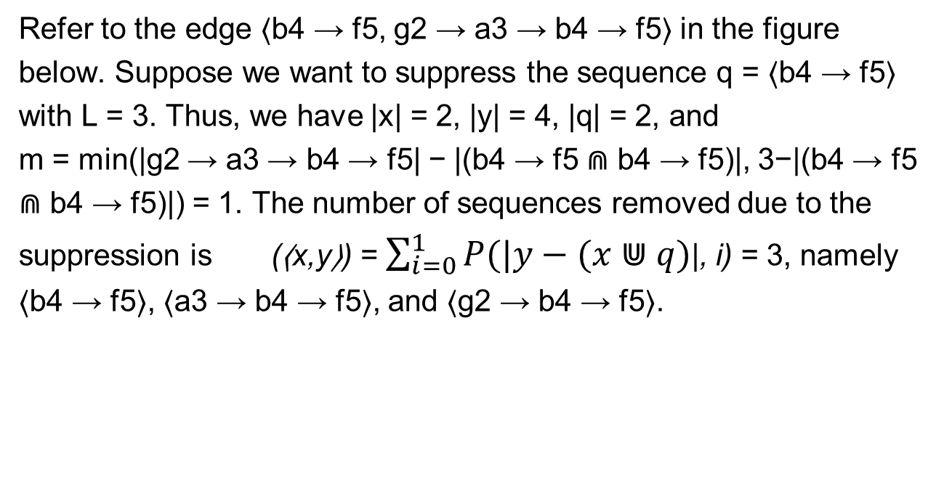

Counting Function - Example
x
y
16

Slide 20
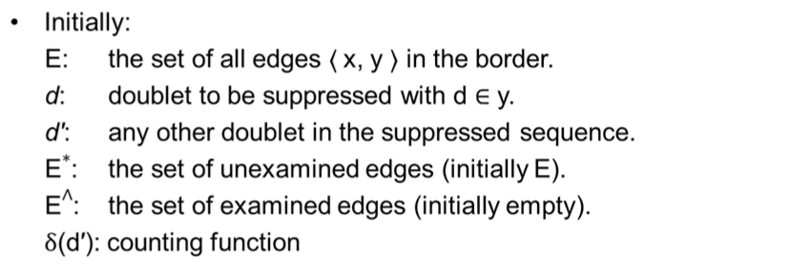

Suppressing Sequences
Select doublet d to be suppressed, with maximum score
Get affected edges
Compute number of affected sequences details next
Update score
Update the borders by removing the violating sequences
17

Slide 21
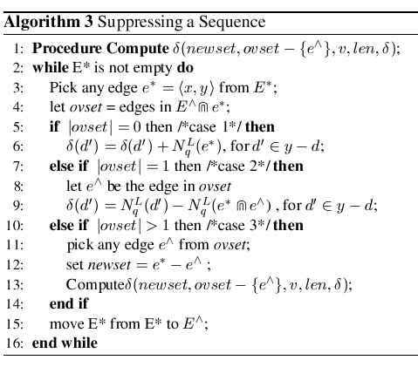
Suppressing Sequences
18

Slide 22
Empirical Study – Dataset
Evaluate the performance of our proposed method:
  Utility loss:
    (F(T) – F(T’)) / F(T), where |F(T)| and |F(T’)| are the numbers of frequent sequences before and after the anonymization.
  Scalability of anonymization.
Dataset:
  Metro100K dataset consists of travel routes of 100,000 passengers in the Montreal subway transit system with 65 stations.
  Each record in the dataset corresponds to the route of one passenger
19

Slide 23
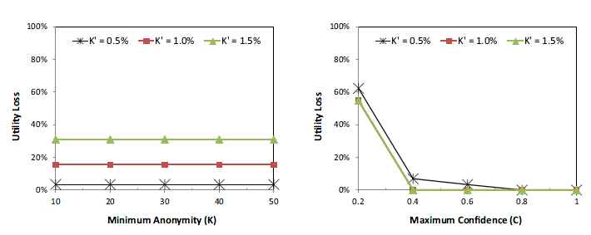
Empirical Results – Utility Loss
20

Slide 24
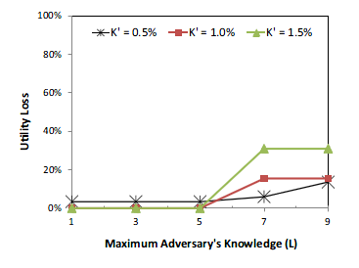
Empirical Results – Utility Loss
20

Slide 25
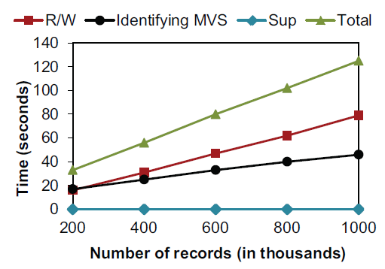
Empirical Results – Utility Loss
21

Slide 26
Related Works
Anonymizing relational data
  Sweeney (2002): k-anonymity
  Wang et al. (2005): Confidence bounding
  Machanavajjhala et al. (2007): l-diversity
  Wong et al. (2009): (α, k)-anonymity
  Noman et al. (2009): LKC-privacy
1

Slide 27
Related Works
Anonymizing trajectory data
  Abul et al. (2008) proposed (k,δ)-anonymity based on space translation.
  Pensa et al. (2008) proposed a variant of k-anonymity model for sequential data, with the goal of preserving frequent sequential patterns.
  Terrovitis and Mamoulis (2008) further assumed that different adversaries may possess different background knowledge and that the data holder has to be aware of all such adversarial knowledge.
1

Slide 28
Related Works
Fung et al. (in press) proposed an SOA for achieving LKC-privacy for relational data mashup. (IEEE Transactions on Services Computing)
Xu et al. (2008) proposed a border-based anonymiztion method for set-valued data.
  Fung et al. (2010): Privacy-preserving data publishing: a survey of recent developments. (ACM Computing Surveys).
1

Slide 29
Summary and Conclusion
Studied the problem of privacy-preserving spatial-temporal data publishing.
Proposed a service-oriented architecture to determine an appropriate location-based service provider for a given data request.
Presented a border-based anonymization algorithm to anonymize a spatial-temporal dataset.
Demonstrated the feasibility to simultaneously preserve both privacy and information utility for data mining.
22

Slide 30
Thank you! Questions?
Contact:
Benjamin Fung <fung@ciise.concordia.ca>
Website:
http://www.ciise.concordia.ca/~fung
1

Slide 31
References
O. Abul, F. Bonchi, and M. Nanni. Never walk alone: Uncertainty for anonymity in moving objects databases. In Proc. of the 24th IEEE International Conference on Data Engineering, pages 376–385, 2008.
B. C. M. Fung, T. Trojer, P. C. K. Hung, L. Xiong, K. Al-Hussaeni, and R. Dssouli. Service-oriented architecture for high-dimensional private data mashup. IEEE Transactions on Services Computing (TSC), in press.
B. C. M. Fung, K. Wang, R. Chen, and P. S. Yu. Privacy-preserving data publishing: A survey of recent developments. ACM Computing Surveys, 42(4):14:1–14:53, June 2010.
A. Machanavajjhala, D. Kifer, J. Gehrke, and M. Venkitasubramaniam. ℓ-diversity: Privacy beyond k-anonymity. ACM TKDD, 1(1):3, March 2007.
1

Slide 32
References
N. Mohammed, B. C. M. Fung, and M. Debbabi. Walking in the crowd: anonymizing trajectory data for pattern analysis. In Proceedings of the 18th ACM Conference on Information and Knowledge Management (CIKM), pages 1441-1444, Hong Kong: ACM Press, November 2009.
N. Mohammed, B. C. M. Fung, P. C. K. Hung, and C. Lee. Anonymizing healthcare data: A case study on the blood transfusion service. In Proc. of the 15th ACM SIGKDD, pages 1285–1294, June 2009.
R. G. Pensa, A. Monreale, F. Pinelli, and D. Pedreschi. Pattern preserving k-anonymization of sequences and its application to mobility data mining. In Proc. of the International Workshop on Privacy in Location-Based Applications, 2008.
L. Sweeney. Achieving k-anonymity privacy protection using generalization and suppression. International Journal of Uncertainty, Fuzziness, and Knowledge-based Systems, 10(5):571–588, 2002.
1

Slide 33
References
M. Terrovitis and N. Mamoulis. Privacy preservation in the publication of trajectories. In Proc. of the 9th International Conference on Mobile Data Management, pages 65–72, Beijing, China, April 2008.
K. Wang, B. C. M. Fung, and P. S. Yu. Template-based privacy preservation in classification problems. In Proceedings of the 5th IEEE International Conference on Data Mining (ICDM), pages 466-473, Houston, TX: IEEE Computer Society, November 2005.
R. C. W. Wong, J. Li., A. W. C. Fu, and K. Wang. (α,k)-anonymous data publishing. Journal of Intelligent Information Systems, 33(2):209–234, October 2009.
Y. Xu, B. C. M. Fung, K. Wang, A. W. C. Fu, and J. Pei. Publishing sensitive transactions for itemset utility. In Proc. of the 8th IEEE International Conference on Data Mining (ICDM), December 2008.
1

