Slide 1

Towards Discovering Criminal Communities from Textual Data
The 26th ACM SIGAPP Symposium on Applied Computing (SAC 2011)
Computer Forensics Track
TaiChung, Taiwan
Rabeah Al-Zaidy Benjamin C. M. Fung Amr M. Youssef
Concordia Institute for Information Systems Security
Concordia University
Montreal, Quebec, Canada

Slide 2
Objectives
Input: A large collection of text documents seized from a suspect’s PC.
Develop a method:
  To identify potential actors from (unstructured) text documents
  To identify the communities among the actors.
  To analyze relationships, identify topics, and extract information relevant to crime investigation.
  To visualize the knowledge found.

Slide 3
Related Work:
Criminal Network Analysis tools
Chen et al. (2004), University of Arizona
  Extract criminal relations from police department’s incident summaries and database.
  Use the co-occurrence frequency to determine the weight of relationships between pairs of criminals.
Yang and Ng (2007)
  Extract criminal networks from websites that provide blogging services by using a topic-specific exploration mechanism.
Our method:
  Extract social networks from unstructured data
  Discover prominent communities consisting of any size, i.e., not limited to pairs of criminals.

Slide 4
Overview of
Criminal Communities Mining System
Phase 1: Identify personal identities
  Apply Stanford Named Entity Tagger to documents
  Merge / remove identities
    e.g., J. Smith & John Smith are merged
Phase 2: Extract prominent communities
Phase 3: Extract relevant information from each prominent community
Phase 4: Visualize the knowledge

Slide 5
Prominent Communities Extraction
Community: a group of identities
k-community: a group of k identities
Prominent community: a community with support greater than or equal to a user-specified minimum support threshold min_sup.
Problem: Identify all prominent communities.
DocID | Identities in d
d1 | {John, Jenny, Tedd}
d2 | {Jenny, Mike, Susan}
d3 | {Jenny, Kim}
d4 | {John, Jenny, Mike}
d5 | {John, Kim}
d6 | {Jenny, Kim}
d7 | {John, Kim}
d8 | {John, Jenny, Kim, Tedd}
d9 | {John, Jenny, Kim}
min_sup = 2

Slide 6
Prominent Communities Extraction
Apriori property: All non-empty subsets of a prominent community must also be prominent, e.g.,
{John, Jenny, Kim} is prominent.
  {John, Jenny}
  {John, Kim}
  {Jenny, Kim}
  {John}
  {Jenny}
  {Kim}
DocID | Identities in d
d1 | {John, Jenny, Tedd}
d2 | {Jenny, Mike, Susan}
d3 | {Jenny, Kim}
d4 | {John, Jenny, Mike}
d5 | {John, Kim}
d6 | {Jenny, Kim}
d7 | {John, Kim}
d8 | {John, Jenny, Kim, Tedd}
d9 | {John, Jenny, Kim}
min_sup = 2

Slide 7
Prominent Communities Extraction
Cand₁ = {{John}, {Jenny}, {Kim}, {Mike}, {Susan}, {Tedd}}
support({John}) = 6
support({Jenny}) = 7
support({Kim}) = 6
support({Mike}) = 2
support({Susan}) = 1
support({Tedd}) = 2
L₁ = {{John}, {Jenny}, {Kim}, {Mike}, {Tedd}}
DocID | Identities in d
d1 | {John, Jenny, Tedd}
d2 | {Jenny, Mike, Susan}
d3 | {Jenny, Kim}
d4 | {John, Jenny, Mike}
d5 | {John, Kim}
d6 | {Jenny, Kim}
d7 | {John, Kim}
d8 | {John, Jenny, Kim, Tedd}
d9 | {John, Jenny, Kim}
min_sup = 2

Slide 8
Prominent Communities Extraction
L₁ = {{John}, {Jenny}, {Kim}, {Mike}, {Tedd}}
L₂ = { {John, Jenny},
{John, Kim},
{John, Tedd},
{Jenny, Kim},
{Jenny, Mike},
{Jenny, Tedd}}
L₃ = {{John, Jenny, Kim},
{John, Jenny, Tedd}}
R({John,Jenny,Kim}) = {d8, d9}
R({John, Jenny, Tedd}) = {d1,d8}
DocID | Identities in d
d1 | {John, Jenny, Tedd}
d2 | {Jenny, Mike, Susan}
d3 | {Jenny, Kim}
d4 | {John, Jenny, Mike}
d5 | {John, Kim}
d6 | {Jenny, Kim}
d7 | {John, Kim}
d8 | {John, Jenny, Kim, Tedd}
d9 | {John, Jenny, Kim}
4
4
2
4
2
2
2
2
min_sup = 2

Slide 9
Extracting Prominent Community Information
The information in the set of documents containing their names bring them together.
Extract useful information from the document set of each prominent community.

Slide 10
Extracting Prominent Community Information (Cont’d)
Key topics
  Apply text summarization method
Names of other people who are not members of the prominent community
  Apply the Stanford NER
Locations and addresses
Phone numbers
E-mail addresses
Website URLs

Slide 11
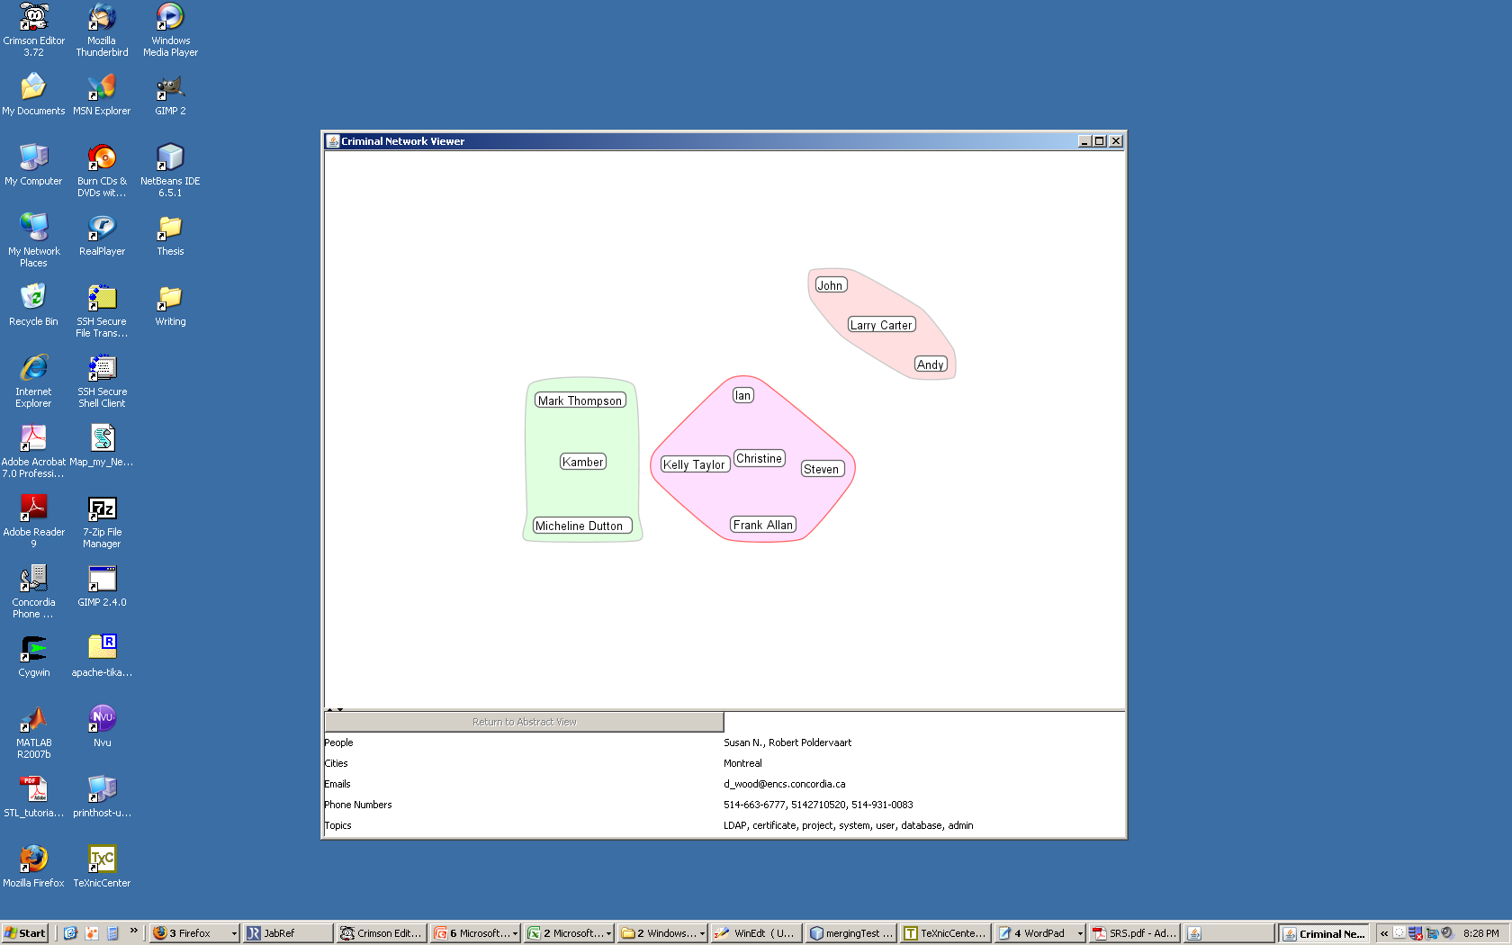
Criminal Communities Mining System

Slide 12
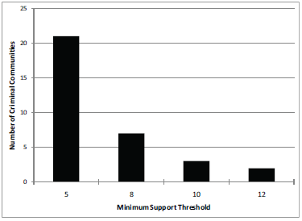
# of Communities vs. Minimum Support

Slide 13
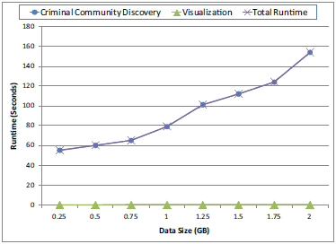
Efficiency & Scalability

Slide 14
Conclusion
Defined the notion of prominent community.
Efficiently identify prominent communities from unstructured text documents.
Measure closeness.
Identify the topics that bring a group together.

Slide 15
Thank you. fung@ciise.concordia.ca

Slide 16
References
Agrawal R, Imieli´nski T, Swami A. Mining association rules between sets of items in large databases. ACM SIGMOD Record 1993;22(2):207–16.
Al-Zaidy R, Fung BCM, Youssef AM. Towards discovering criminal communities from textual data. In: Proc. of the 26th ACM SIGAPP Symposium on Applied Computing (SAC). TaiChung, Taiwan; 2011.
Chen H, Chung W, Xu JJ, Wang G, Qin Y, Chau M. Crime data mining: a general framework and some examples. Computer 2004;37(4):50–6.
Finkel JR, Grenager T, Manning C. Incorporating non-local information into information extraction systems by gibbs sampling. In: Proc. of the 43rd Annual Meeting on Association for Computational Linguistics (ACL). 2005. p. 363–70.
Friedl JEF. Mastering Regular Expressions. 3rd ed. O’Reilly Media, 2006. Geobytes Inc . Geoworldmap. 2003. http://www.geobytes.com/.
Getoor L, Diehl CP. Link mining: a survey. ACM SIGKDD Explorations Newsletter 2005;7(2):3–12.
Hope T, Nishimura T, Takeda H. An integrated method for social network extraction. In: Proc. of the 15th International Conference on World Wide Web (WWW). 2006. p. 845–6.
Jin W, Srihari RK, Ho HH. A text mining model for hypothesis generation. In: Proc. of the 19th IEEE International Conference on Tools with Artificial Intelligence ICTAI. 2007. p. 156–62.

Slide 17
References
Jin Y, Matsuo Y, Ishizuka M. Ranking companies on the web using social network mining. In: Ting IH, Wu HJ, editors. Web Mining Applications in E-commerce and E-services. Springer Berlin / Heidelberg; volume 172 of Studies in Computational Intelligence; 2009. p. 137–52.
RCFL . Regional computer forensic laboratory annual report 2009. Technical Report; Federal Bureau of Investigation; 2009. http://www.rcfl.gov/downloads/documents/RCFL Nat Annual09.pdf.
Rotem N. Open text summarizer. 2003. http://libots.sourceforge.net/.
Skillicorn DB, Vats N. Novel information discovery for intelligence and counterterrorism. Decision Support Systems 2007;43(4):1375 –82.
Srinivasan P. Text mining: Generating hypotheses from medline. Journal of the American Society for Information Science and Technology 2004;55:396–413.
Xu J, Chen H. Criminal network analysis and visualization. Communications of the ACM 2005;48(6):100–7.
Yang CC, Ng TD. Terrorism and crime related weblog social network: Link, content analysis and information visualization. In: IEEE International Conference on Intelligence and Security Informatics (ISI). 2007. p. 55–8.
Zhou D, Manavoglu R, Li J, Giles CL, Zha H. Probabilistic models for discovering e-communities. In: Proc. of the 15th International Conference on World Wide Web (WWW). 2006. p. 173–82.

