Slide 1


Kam1n0:
Assembly Clone Search for Reverse Engineering
Steven Ding
Data Mining and Security Lab
School of Information Studies
McGill University
Montreal, Canada
Benjamin C. M. Fung
Data Mining and Security Lab
School of Information Studies
McGill University,
Montreal, Canada
Philippe Charland
Mission Critical Cyber Security Section
Defence R&D Canada – Valcartier
Quebec, Canada

Slide 2
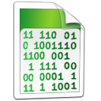
Reverse Engineering
0xEB68 PUSH {R7,LR}
0xEB6A SUB SP, SP, #0x10
0xEB6C ADD R7, SP, #0
0xEB6E STR R0, [R7,#0x10+s]
0xEB70 STR R1, [R7,#0x10+buf]
0xEB72 STR R2, [R7,#0x10+len]
0xEB74 STR R3, [R7,#0x10+header]
0xEB76 LDR R0, [R7,#0x10+s]
0xEB78 BL bi_windup
0xEB7C LDR R3, [R7,#0x10+s]
0xEB7E ADD.W R3, R3, #0x16A0
0xEB82 ADDS R3, #0x14
0xEB84 MOVS R2, #8
0xEB86 STR R2, [R3]
0xEB88 LDR R3, [R7,#0x10+header]
0xEB8A CMP R3, #0
0xEB8C BEQ loc_EBFC
0xEB8E LDR R3, [R7,#0x10+s]
0xEB90 LDR R2, [R3,#8]
0xEB92 LDR R3, [R7,#0x10+s]
0xEB94 LDR R3, [R3,#0x14]
0xEB96 ADDS R0, R3, #1
0xEB98 LDR R1, [R7,#0x10+s]
0xEB9A STR R0, [R1,#0x14]
0xEB9C ADD R3, R2
0xEB9E LDR R2, [R7,#0x10+len]
0xEBA0 UXTB R2, R2
0xEBA2 STRB R2, [R3]
0xEBA4 LDR R3, [R7,#0x10+s]
0xEBA6 LDR R2, [R3,#8]
0xEBA8 LDR R3, [R7,#0x10+s]
0xEBAA LDR R3, [R3,#0x14]
0xEBAC ADDS R0, R3, #1
0xEBAE LDR R1, [R7,#0x10+s]
0xEBB0 STR R0, [R1,#0x14]
0xEBB2 ADD R3, R2
0xEBB4 LDR R2, [R7,#0x10+len]
0xEBB6 UXTH R2, R2
0xEBB8 LSRS R2, R2, #8
0xEBBA UXTH R2, R2
0xEBBC UXTB R2, R2
0xEBBE STRB R2, [R3]
0xEBC0 LDR R3, [R7,#0x10+s]
0xEBC2 LDR R2, [R3,#8]
0xEBC4 LDR R3, [R7,#0x10+s]
0xEBC6 LDR R3, [R3,#0x14]
0xEBC8 ADDS R0, R3, #1
0xEBCA LDR R1, [R7,#0x10+s]
0xEBCC STR R0, [R1,#0x14]
0xEBCE ADD R3, R2
0xEBD0 LDR R2, [R7,#0x10+len]
0xEBD2 UXTB R2, R2
0xEBD4 MVNS R2, R2
0xEBD6 UXTB R2, R2
0xEBD8 STRB R2, [R3]
0xEBDA LDR R3, [R7,#0x10+s]
0xEBDC LDR R2, [R3,#8]
0xEBDE LDR R3, [R7,#0x10+s]
0xEBE0 LDR R3, [R3,#0x14]
0xEBE2 ADDS R0, R3, #1
0xEBE4 LDR R1, [R7,#0x10+s]
0xEBE6 STR R0, [R1,#0x14]
0xEBE8 ADD R3, R2
0xEBEA LDR R2, [R7,#0x10+len]
0xEBEC UXTH R2, R2
0xEBEE MVNS R2, R2
0xEBF0 UXTH R2, R2
0xEBF2 LSRS R2, R2, #8
0xEBF4 UXTH R2, R2
0xEBF6 UXTB R2, R2
0xEBF8 STRB R2, [R3]
0xEBFA B loc_EC18
0xEBFC B loc_EC18
0xEBFE LDR R3, [R7,#0x10+s]
0xEC00 LDR R2, [R3,#8]
0xEC02 LDR R3, [R7,#0x10+s]
0xEC04 LDR R3, [R3,#0x14]
0xEC06 ADDS R0, R3, #1
0xEC08 LDR R1, [R7,#0x10+s]
0xEC0A STR R0, [R1,#0x14]
0xEC0C ADD R2, R3
0xEC0E LDR R3, [R7,#0x10+buf]
0xEC10 ADDS R1, R3, #1
0xEC12 STR R1, [R7,#0x10+buf]
0xEC14 LDRB R3, [R3]
0xEC16 STRB R3, [R2]
0xEC18 LDR R3, [R7,#0x10+len]
0xEC1A SUBS R2, R3, #1
0xEC1C STR R2, [R7,#0x10+len]
0xEC1E CMP R3, #0
0xEC20 BNE loc_EBFE
0xEC22 ADDS R7, #0x10
0xEC24 MOV SP, R7
0xEC26 POP {R7,PC}
void copy_block(deflate_state * s, charf * buf, unsigned len, int header){
bi_windup(s);
s->last_eob_len = 8;
if (header) {
put_short(s, (ush)len);
put_short(s, (ush)~len);
}
}
Reverse Engineering
Notes:
Malware analysis
Patent infringements
Software plagiarism

Slide 3
Reverse Engineering
Malware analysis
  understanding the inner workings of new malware
  exploring new vulnerabilities in existing systems
Patent infringements and software plagiarism
  GNU violation
Code reuse
  Software vulnerability uncontrollably shared between projects
Notes:
Challenges
Manually intensive and time-consuming
Much steeper learning curve than programming
Code reuse – duplicated parts that have been analyzed before
Large scale, big data
82,000 new strains of malware generated on average per day in 2013
230,000 per day in 2014

Slide 4
Assembly Clone Detection
Original problem proposed by DRDC
  A repository of commented assembly code
  Try to transfer comments on existing assembly code to the assembly code under study/analysis
  Abstract concept
  No concrete definition of what is a clone
Type I: literally identical
Type II: syntactically equivalent
Type III: minor modifications

Slide 5


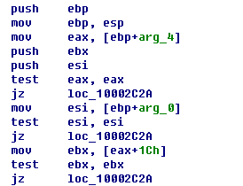

Narrow down the use scenario
Reverse engineer
Did anyone analyze something similar before?
Is it some library function?

Slide 6
Assembly Code Search
Comments
…
Assembly Code
Control Flow Graph

Slide 7
Subgraph Clones
New binary
Comments

Slide 8
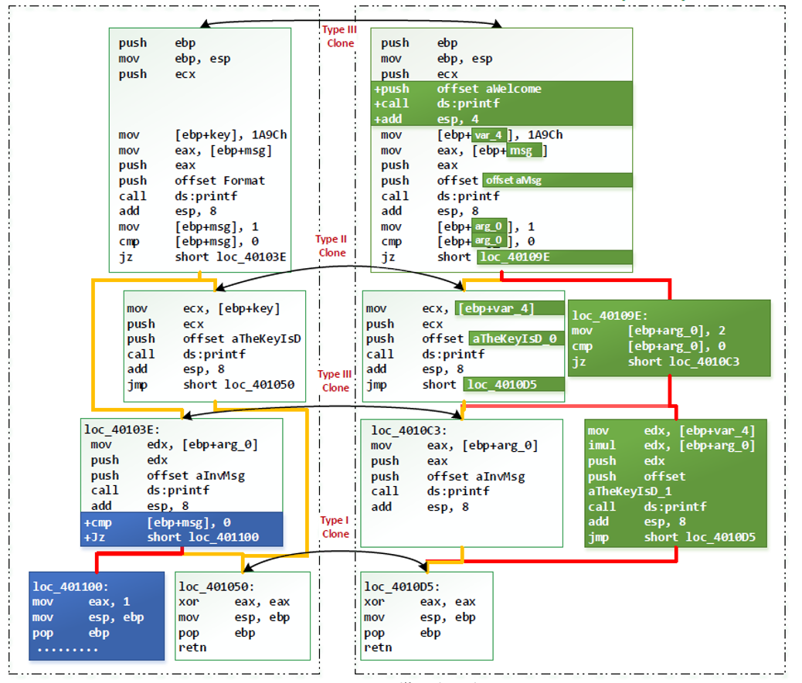
Clone Types

Slide 9
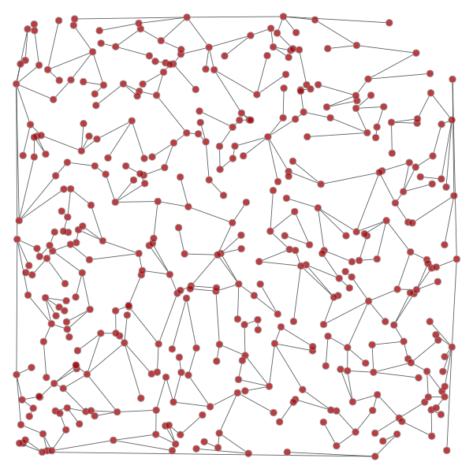
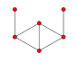
Scalability (subgraph search)

Slide 10
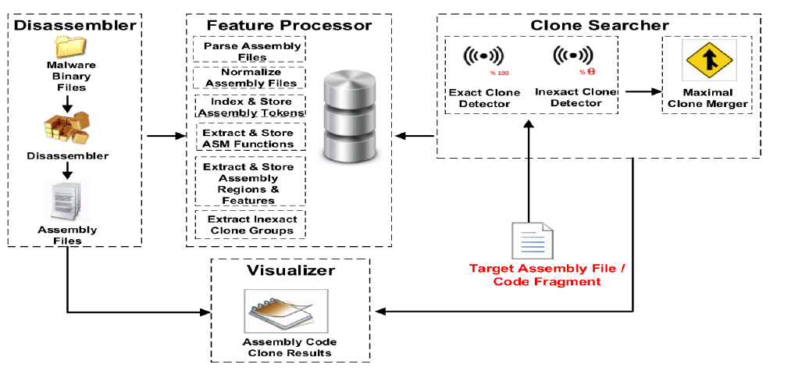
First solution: BinClone

Slide 11
Challenges
Accuracy: false positive rate
Efficiency and scalability: response time with terabytes of assembly code in repository
Incremental update of the repository
Interpretability and usability
Flexibility: binary files with different CPU architectures, compilers, and optimization options
Notes:
Challenges
Manually intensive and time-consuming
Much steeper learning curve than programming
Code reuse – duplicated parts that have been analyzed before
Large scale, big data
82,000 new strains of malware generated on average per day in 2013
230,000 per day in 2014

Slide 12
Finding Clones

Slide 13




Overall Solution Stack
IDA-Pro Connector (Plugin)
Web-based user interface and clone visualization
JQuery
D3js
Dagre
Bootstrap
Results in Json format
RESTful API web services
Kam1n0 engine
HTTP
POST/GET
LSH-based assembly code clone search
MR-based subgraph search
Assembly code processing utilities
Return results
Distributed/Local Map-Reduce compatible execution framework
(Memory and CPUs)
Submit jobs
Apache Spark:
Local mode or distributed mode
Load/cache data
Persists data
Data Storage layer (hard drives)
Graph-based data storage model
Bucket-based data storage model
No-SQL database
Apache Cassandra
Notes:
7.5mins

Slide 14
Distributed deployment
Yarn Node Manager
The Kam1n0 Engine Node
Spark Worker Node
(Spark executor)
Yarn Resource Manager
Cassandra Data Node
The Kam1n0 Engine Node
Yarn Node Manager
Yarn Node Manager
Spark Application Master
Spark Worker Node
(Spark executor)
The Kam1n0 Engine Node
Cassandra Data Node
Yarn Node Manager
Map-Reduce Jobs
Spark Worker Node
(Spark executor)
Cluster management
Cassandra Data Node connections
Cassandra Data Node
Notes:
YARN is now characterized as a large-scale, distributed operating system for big data applications. In 2012, YARN became a sub-project of the larger Apache Hadoop project. Sometimes called MapReduce 2.0, YARN is a software rewrite that decouples MapReduce's resource management and scheduling capabilities from the data processing component, enablingHadoop to support more varied processing approaches and a broader array of applications. For example, Hadoop clusters can now run interactive querying and streaming data applications simultaneously with MapReduce batch jobs. The original incarnation of Hadoop closely paired the Hadoop Distributed File System (HDFS) with the batch-orientedMapReduce programming framework, which handles resource management and job scheduling on Hadoop systems and supports the parsing and condensing of data sets in parallel. Source: http://searchdatamanagement.techtarget.com/definition/Apache-Hadoop-YARN-Yet-Another-Resource-Negotiator

Slide 15
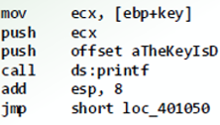
Efficiency (k-NN problem)

Slide 16
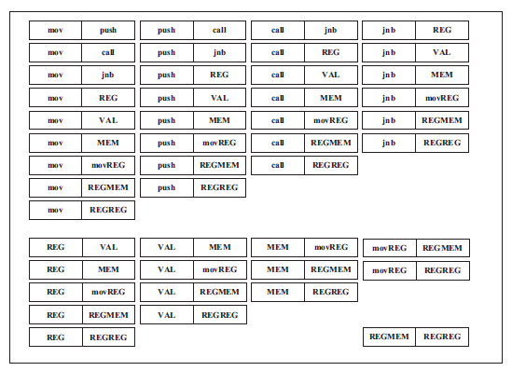
Efficiency (k-NN problem)
Bin-Clone:
  Inefficient and not scalable
    Two combination of feature elements.
    Less accurate

Slide 17
Locality Sensitive Hashing
Efficiency (k-NN problem)
Equal partitioning and static hashing

Slide 18
Efficiency (k-NN problem)
Adaptive Locality Sensitive Hashing
Unequal partitioning and dynamic hashing for cosine space

Slide 19
Scalability (subgraph search)
Mapper
Reducer
A block-to-block
clone pair
A cloned subgraph
Cloned subgraphs
of a function

Slide 20
Software Demonstration: Kam1n0
Notes:
6 min

Slide 21
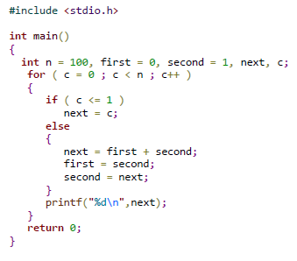
Ground-truth dataset generation
CCfinderX
…
0.9
0.9
…

Slide 22
Experiment - Dataset

Slide 23
Evaluation (quality)
Area Under the Receiver Operating Characteristic Curve (AUROC)
Notes:
AUROC: True positive rate vs. False positive rate

Slide 24
Evaluation (quality)
Area Under the Precision-Recall Curve (AUPR)
Notes:
AUROC: True positive rate vs. False positive rate

Slide 25
Evaluation (quality)
Mean Average Precision at Position 10 (MAP@10)
Notes:
AUROC: True positive rate vs. False positive rate

Slide 26
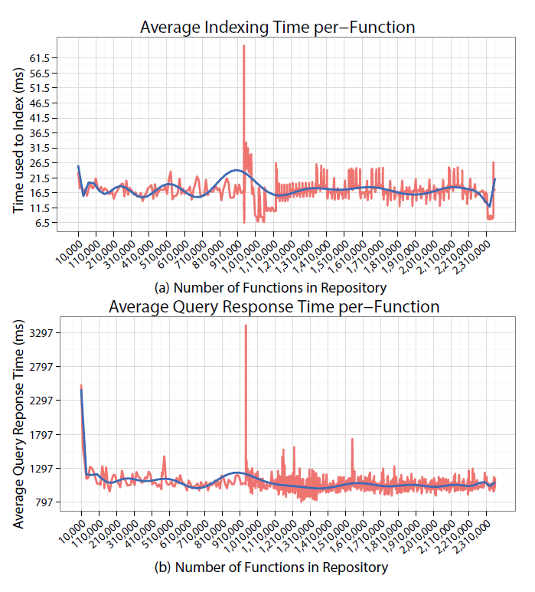
Evaluation (scalability and efficiency)
~20ms to index a function
~1s to find the clones of a function

Slide 27
Summary: Kam1n0
Features
  High accuracy
  Efficient and scalable
  Handle multiple CPU architectures
  Visualizable results
  It’s free with no catch!
Future work
  Malware
  Clone search on binaries of different CPU architectures

Slide 28
Thank you. Questions?
Recruitment: PhD students in data mining and security
Benjamin Fung
McGill Data Mining and Security Lab
http://dmas.lab.mcgill.ca/fung
E-mail: ben.fung (at) mcgill.ca
Notes:
2.5mins

