Slide 1

Privacy Protection for RFID Data
Benjamin C.M. Fung
Concordia Institute for
Information systems
Engineering
Concordia university
Montreal, QC, Canada
fung@ciise.concordia.ca
Ming Cao
Concordia Institute for
Information systems
Engineering
Concordia university
Montreal, QC, Canada
min_ca@ciise.concordia.ca
Bipin C. Desai
Department of Computer
Science & Software
Engineering
Concordia university
Montreal, QC, Canada
bcdesai@cs.concordia.ca
Heng Xu
College of
Information Science
and Technology
Penn State University
University Park, PA 16802
hxu@ist.psu.edu
Notes:
The work has been published on ACM SIGAPP SAC, and it is joint work with the Department of Computer Science and Penn State University.

Slide 2

Agenda
What is RFID ?
Privacy Threats
Privacy Protection Model – LKC Model
Efficient Algorithm
Empirical Study
Conclusion and Future Work

Slide 3
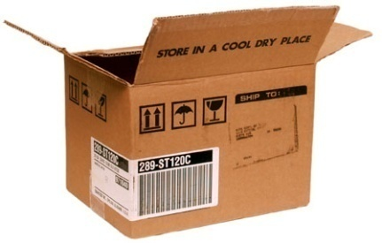
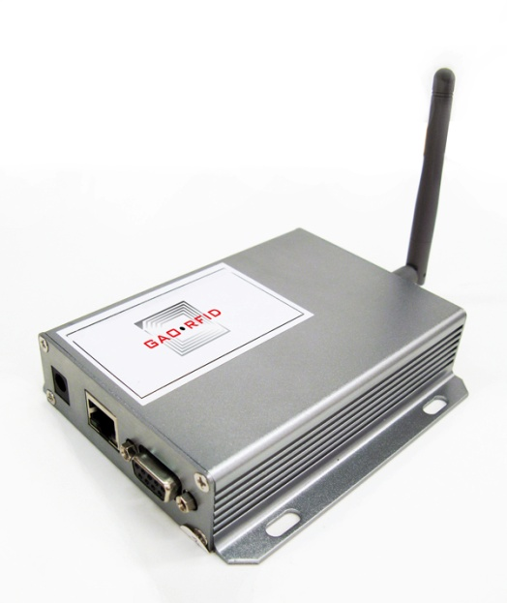
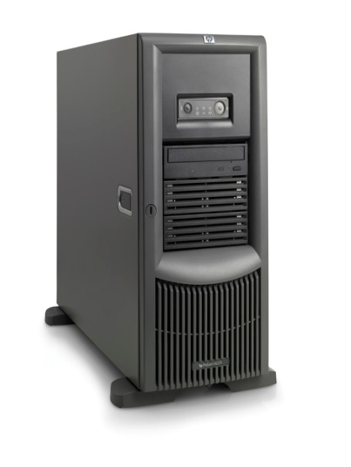
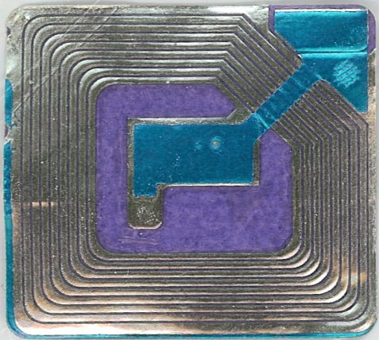
What is RFID?
Radio Frequency Identification (RFID)
  Technology that allows a sensor (reader) to read, from a distance, and without line of sight, a unique electronic product code (EPC) associated with a tag
Interrogate
(EPC, time)
EPC
Tag
Reader
Server
Notes:
RFID is a technology that uses radio-frequency waves to transfer data between a reader and a movable item to identify, categorize, track...
RFID is fast, reliable, and does not require physical sight or contact between reader/scanner and the tagged item
Tags can be attached to
almost anything:
pallets or cases of product
vehicles
company assets or personnel
items such as apparel,
luggage, laundry
people, livestock, or pets
high value electronics such
as computers, TVs, camcorders

Slide 4
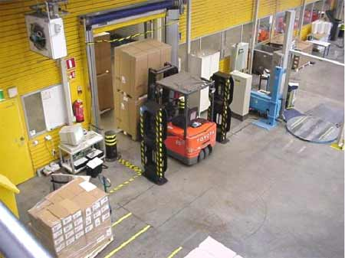
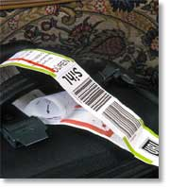
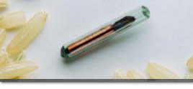
Application of RFID ?
Supply Chain Management: Real-time inventory tracking
Retail: Active shelves monitor product availability
Access control: Toll collection, credit cards, building access
Airline luggage management: Reduce lost/misplaced luggage
Medical: Implant patients with a tag that contains their medical history
Pet identification: Implant RFID tag with pet owner information
Notes:
The declining cost of RFID systems along with improved sensitivity and durability has increased its usage potential in the logistical, planning and supply chain process.
You may find RFID application around us. For example, wal-mart deploy RFID tag for supply chain checking.
In access control application, as you may all have, Concordia RFID access card.
Hospital deploy RFID card to track their expensive medical device and asset. Even in credit card industry, Mastercard implement RFID technology so that you don’t have to swap the credit for the pos machine.
I would like talk about some common know RFID Tag.

Slide 5
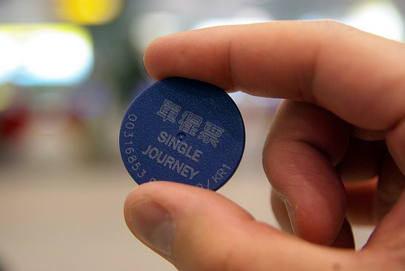
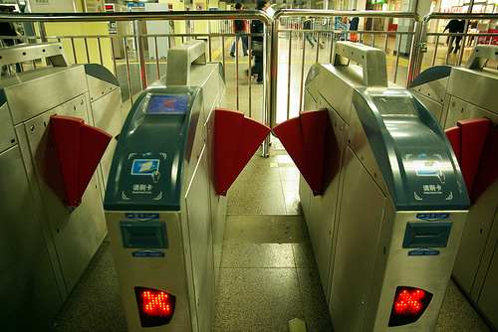

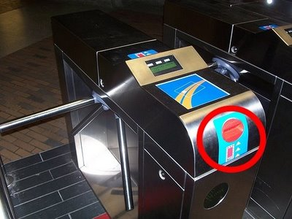
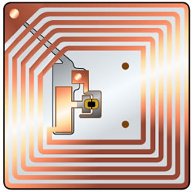
What is RFID – RFID Tag and Receiver
spacingmontreal.ca
Notes:
An RFID tag is a microchip combined with an antenna in a compact package; the packaging is structured to allow the RFID tag to be attached to an object to be tracked.
I have prepared some RFID tags to give you some idea what is RFID tag looks like ?

Slide 6
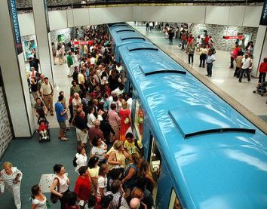
RFID Ticketing System
According to the STM website, the metro system has transported over 6 billion passengers as of 2006, roughly equivalent to the world's population

Slide 7
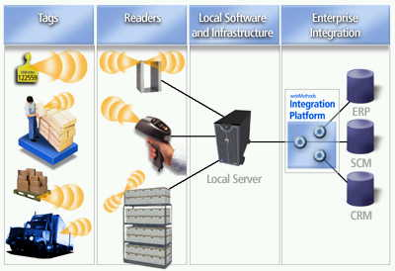
What is RFID-Tag and Database?
Source: KDD 08 Tutorial
Notes:
In general, there are a lot of readers will send the signal to the RFID tag, and RFID will reflect their identities to authenticate with the server. This mechanism is saved by the backend database. The information are valuable to management and decision maker. Hong Kong deployed RFID tag in their public transit to analysis it and continue improving the city traffic.

Slide 8
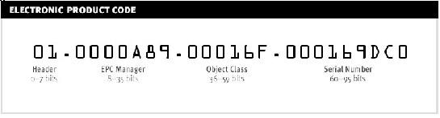
RFID Data
Trajectories
App Events
Raw Events
[EPC: (L₁,T₁)(L₂,T₂)…(L_{n},T_{n})]
[EPC, Location, Time_in, Time_out]
[EPC, Location, Time]

Slide 9
RFID Data
Three models in typical RFID applications
  Bulky movements: supply-chain management
  Scattered movements: E-pass tollway system
  No movements: fixed location sensor networks
Different applications may require different data warehouse systems
Our discussion will focus on Scattered movements
Source: KDD 08 Tutorial

Slide 10
Object Specific Path Table
{(loc₁t₁) →…→ (loc_{n}t_{n}) }:s₁,…,s_{p} : d₁,…,d_{m}
Where {(loc₁t₁) →…→ (loc_{n}t_{n}) is a path, s₁,…,s_{p} are sensitive attributes, and ₁,…,d_{m}are quasi-identifying(QID) attributes associated with object.

Slide 11
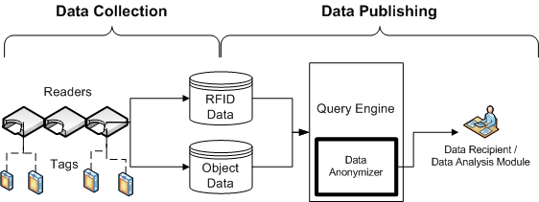
RFID Data Mining

Slide 12
Object Specific Path Table
EPC | Path | Name | Diagnose
1 | McGill 7 -> Concordia 8 -> McGill 17 | Bob | Flu
2 | Atwater 7 -> Concordia 8 -> Vendome 13 -> Cote-Vertu 18 -> St-Laurent 22 | Joe | HIV
3 | LaSalle 8 -> Concordia 9 -> Snowdon 18 -> Place -D'Armes 19 -> Longueuil 24 | Alice | Flu
4 | Cote-vertu 7 -> Concordia 8 -> Cote-Vertu 17 | Ken | SARS
5 | Atwater 7 -> Concordia 8 -> Vendome 13 -> Cote-Vertu 18 -> Atwater 20 | Julie | HIV

Slide 13



Privacy Act
"Under agreement with the Québec privacy commission, any data used for analytical purpose has user identification stripped out. Access by law enforcement agencies is permitted only by court order." - Steve Munro
Notes:
This means that the government, universities (analytical research), and law enforcement agencies cannot track a particular person without a court order.

Slide 14
A simple Attack
EPC | Path | Name | Diagnose
1 | McGill 7 -> Concordia 8 -> McGill 17 | Bob | Flu
2 | Atwater 7 -> Concordia 8 -> Vendome 13 -> Cote-Vertu 18 -> St-Larent 22 | Joe | HIV
3 | Lassale 8 -> Concordia 9 -> Snowdon 18 -> Place -D'Arms 19 -> Longueul 24 | Alice | Flu
4 | Cote-vertu 7 -> Concordia 8 -> Cote-Vertu 7 | Ken | SARS
5 | Atwater 7 -> Concordia 8 -> Vendome 13 -> Cote-Vertu 18 -> Atwater 20 | Julie | HIV

Slide 15
A simple Attack
EPC | Path | Diagnose
1 | McGill 7 -> Concordia 8 -> McGill 17 | Flu
2 | Atwater 7 -> Concordia 8 -> Vendome 13 -> Cote-Vertu 18 -> St-Larent 22 | HIV
3 | Lassale 8 -> Concordia 9 -> Snowdon 18 -> Place -D'Arms 19 -> Longueul 24 | Flu
4 | Cote-vertu 7 -> Concordia 8 -> Cote-Vertu 7 | SARS
5 | Atwater 7 -> Concordia 8 -> Vendome 13 -> Cote-Vertu 18 -> Atwater 20 | HIV

Slide 16
RFID Data Privacy Threats
Record Linkage
If a path in the table is so specific that not many people match it, releasing the RFID data may lead to linking the victim's record, and therefore, her contracted diagnosis.
Attribute Linkage
If a sensitive value occurs frequently together with some combination of pairs, then the sensitive information can be inferred from such combination even though the exact record of the victim cannot be identified.
Our Goal: preserving data privacy while preserving data usefulness

Slide 17
Problem of Traditional K-Anonymity in high dimensional, sparse data
Increasing the number of attributes will increase the information loss(ex: 50x12=600 dimension)
High Distortion Rate
Assume attacker prior knowledge is bounded by at most L pairs of location and timestamp
Ensure every possible subsequence q with maximum length L in any path a RFID data table is shared by at least K records and confidence to infer sensitive value not more than C.

Slide 18
LK Anonymity
An object-specific path table T satisfies LK anonymity if and only if |G(q)| ≥ K for any subsequence q with |q| ≤ L of any path in T, where K is a positive anonymity threshold.
IG(q)I is the adversary prior knowledge that could identify a group of record in T.

Slide 19
LC Dilution
Let S be a set of data holder-specified sensitive values from sensitive attributes S₁,…,S_{m}. An object-specific path table T satisfies LC-dilution if and only if Conf(s|G(q)) ≤ C for any s S and for any subsequence q with |q| < L of any path in T, where 0 ≤C ≤ 1 is a confidence threshold.
Conf(s|G(q)) is the percentage of the records in IG(q)I containing S.

Slide 20
LKC Privacy
An object-specific path table T satisfies LKC-privacy if T satisfies both LK-anonymity and LC-dilution.
Notes:
LK-anonymity bounds the probability of a successful record linkage to ≤ 1/K. LK-dilution bounds the probability of a successful attribute linkage to ≤ C. LKC-privacy bounds both. Note, not all values in sensitive attributes S₁,…,S_{m} are sensitive. For example, HIV could be sensitive, but flu may not be. Our proposed privacy model is flexible to accommodate different privacy need by allowing the data holder to specify a set of sensitive values S.

Slide 21
Problem Definition
We can transform an object-specific path table T to satisfy LKC-privacy by performing a sequence of suppressions on selected pairs from T. In this paper, we employ global suppression, meaning that if a pair p is chosen to be suppressed, all instances of p in T are suppressed.

Slide 22
Algorithm
Phase 1
Identifying critical violations
Phase 2
Removing critical violations

Slide 23
Phase 1-Violation
Let q be a subsequence of a path in T with |q| ≤ L and |G(q)| > 0. q is a violation with respect to a LKC-privacy requirement if |G(q)| < K or Conf(s|G(q)) > C.

Slide 24
Phase 1-Critical Violation
A violation q is a critical violation if every proper subsequence of q is a non-violation.
Observation: A table T₀ satisfies LKC-privacy if and only if T₀ contains no critical violation because each violation is a super sequence of a critical violation. Thus, if T₀ contains no critical violations, then T₀ contains no violations.

Slide 25
Phase 1-Efficient Search and Apriori Algorithm
We propose an algorithm to efficiently identify all critical violations in T with respect to a LKC-privacy requirement. We generate all critical violations of size i+1, denoted by V_{i+1}, by incrementally extending non-violations of size i, denoted by U_{i}, with an additional pair.

Slide 26
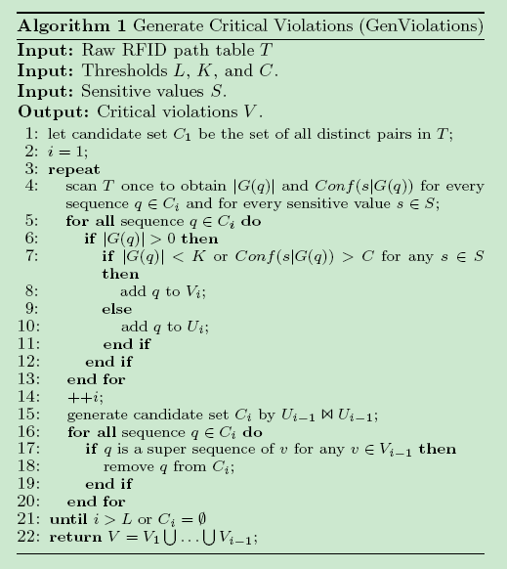
Phase 1-Identifying Violation
Notes:
This slide presents our efficient algorithm to generate critical violations. Again, we are not going to detail of the algorithm. herer A simple note for this slide is that by implement apriori algorithm and efficient search of violation tree, we increase our efficiency of generating critical violations tree because this is used to be the bottleneck of the entire program. For those of you interested in the program, you can find more information about apriori algorithm or discuss with me later.

Slide 27
Phase 2-Removing Critical Violation
Now we have a set of critical violation set.
A naïve approach, removing all the violation set.

Slide 28
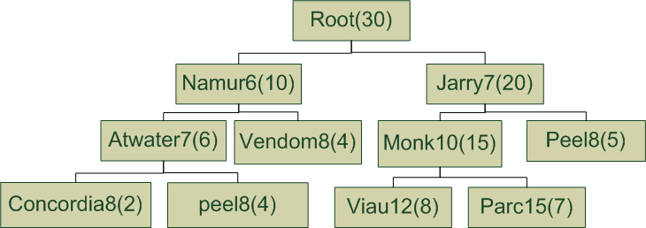
Phase 2-Critical Violation Tree(Example)

Slide 29
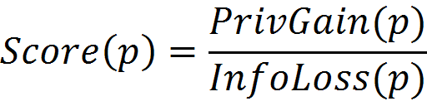
Phase 2-Score Function

Slide 30
Greedy Algorithm: RFID Data Anonymizer
Input: Raw RFID path table T Input: Thresholds L , K , C. Input: Sensitive values S.
Output: Anonymous T’ that satisfies LKC-privacy
1: V= Call Gen Violations(T, L,K,C,S) in Algorithm 1; 2: build the Critical Violation Tree (CVT) with Score Table; 3: while Score Table is not empty do 4: select winner pair w that has the highest Score; 5: delete all critical violations containing w in CVT; 6: update Score of a candidate; 7: remove w in Score Table; 8: add w to Sup 9: end while

Slide 31
Empirical Study – Implementation Environment
All experiments were conducted on a PC with Intel Core2 Quad 2.4GHz with 2GB of RAM
The employed data set is a simulation of the travel route of 20,000 passenger

Slide 32
Empirical Study- Distortion Analysis

Slide 33
Empirical Study- Score Function

Slide 34
Empirical Study- Efficiency and Scalability

Slide 35
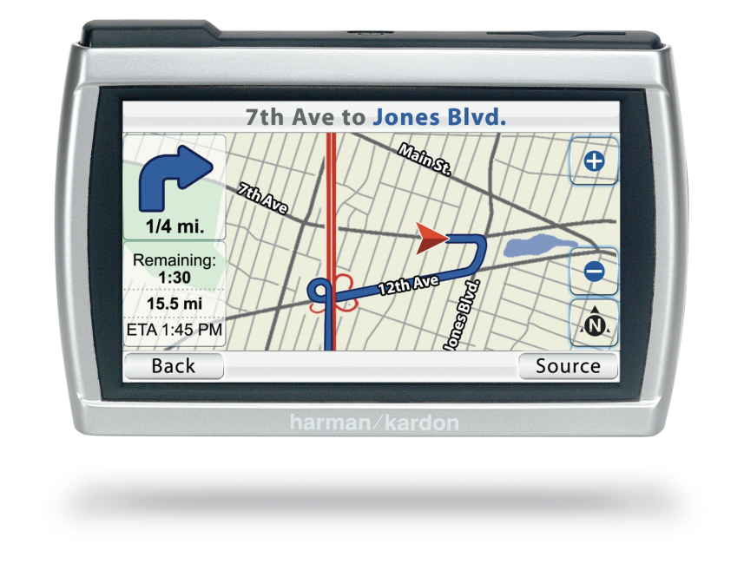
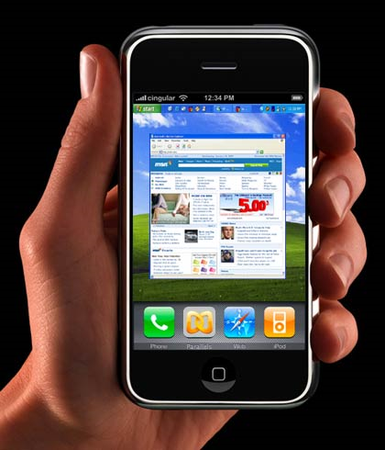
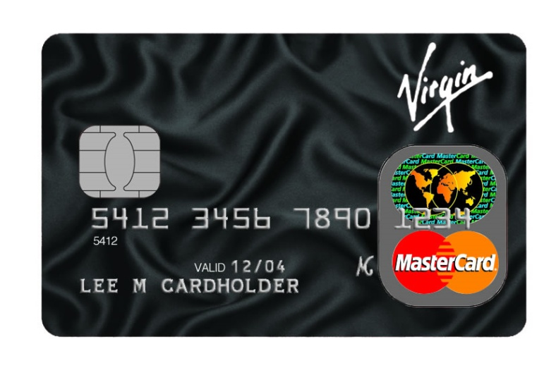
Powerful LKC Model with other data

Slide 36
Conclusion
We illustrate the privacy threats caused by publishing RFID data
Formally define a privacy model, called LKC privacy for high dimensional, sparse RFID data
Propose an efficient anonymization algorithm to transform a RFID data set to satisfy a given LKC-privacy requirement

Slide 37
Paper
Our paper titled “Privacy Protection for RFID Data” has been accepted at ACM SAC 2009.
B. C. M. Fung, M. Cao, B. C. Desai, and H. Xu. Privacy protection for RFID data. In Proceedings of the 24th ACM SIGAPP Symposium on Applied Computing (SAC 2009) Special Track on Database Theory, Technology, and Applications (DTTA), Honolulu, HI: ACM Press, March 2009.

Slide 38
Future Work
Implement different anonymization methods: generalization or permutation.
New attack scenario with QID
Enhanced Score function

Slide 39
Acknowledgement
The research is supported in part by the Discovery Grants(356065-2008) from Natural Sciences and Engineering Research Council of Canada(NSERC)

Slide 40
Reference:
KDD 08 Tutorial, Mining Massive RFID trajectory, and traffic Data Sets, Jiawei Han, Jae-Gil Lee, Hector Gonzalez, Xiaolei Li, ACM SIGKDD’08 Conference Tutorial, Las Vegas, NV
www.spacemontreal.com
Office of the Privacy Commissioner

