Slide 1
A Novel Approach of Mining Write-Prints for Authorship Attribution in E-mail Forensics
Farkhund Iqbal
Benjamin C. M. Fung
Rachid Hadjidj
Mourad Debbabi
Computer Security Lab
Concordia Institute for Information Systems Engineering
Concordia University
Montreal, Canada

Slide 2
Authorship Identification
A person wrote an email, e.g., a blackmail or a spam email.
Later on, he denied to be the author.
Our goal: Identify the most plausible authors and find evidence to support the conclusion.

Slide 3

Cybercrime via E-mails
My real-life example: Offering homestay for international students.
My home
Carmela in US
Same person
Anthony in Canada

Slide 4
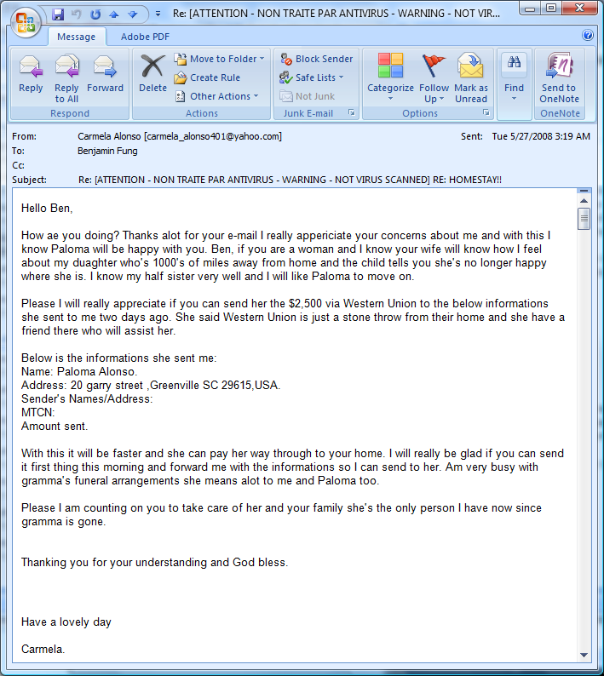
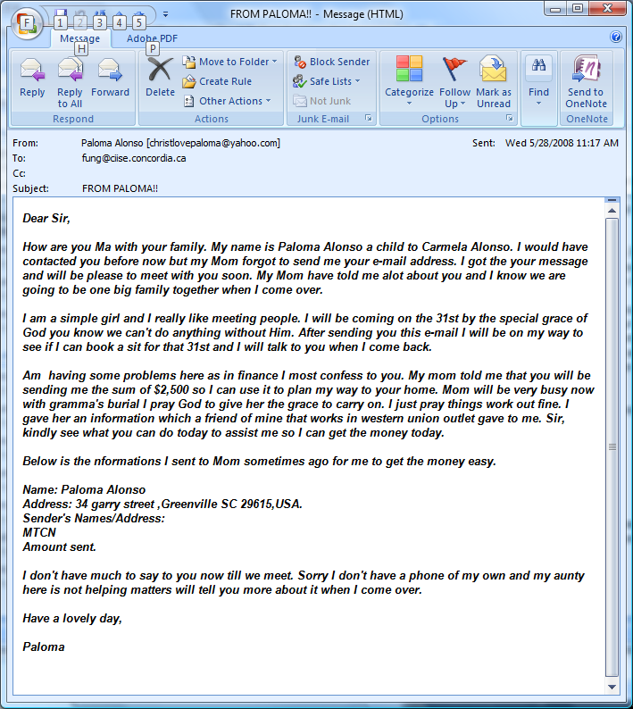
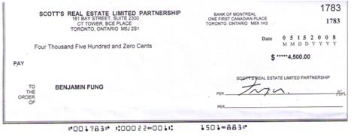
Evidence I have
Cell phone number of Anthony: 647-8302170
15 e-mails from “Carmela”
A counterfeit cheque
Anthony

Slide 5
The Problem
Suspect S₁
Suspect S₂
Suspect S₃
To determine the author of a given malicious e-mail μ.
Assumption #1: the author is likely to be one of the suspects.
Assumption #2: have access to suspects’ previously written e-mails.
The problem is
  to identify the most plausible author from the suspects, and
  to gather convincing evidence to support the finding.
E-mails E₁
E-mails E₂
E-mails E₃
Email μ from unknown author

Slide 6

Current Approach
E-mails E₁
E-mails E₂
E-mails E₃
Email μ from unknown author
Classification Model
Capital Ratio
[0,0.3)
[0.5,1)
[0.3,0.5)
# of Commas
S1
S2
<0.5
>0.5
S3
……

Slide 7
Related Work
Abbasi and Chen (2008) presented a comprehensive analysis on the stylistics features.
Lexical features [Holmes 1998; Yule 2000,2001]
  characteristics of both characters and words or tokens.
  vocabulary richness and word usage.
Syntactic features (Burrows, 1989; Holmes and Forsyth, 1995; Tweedie and Baayen, 1998)
  the distribution of function words and punctuation.

Slide 8
Related Work
Structural features
  measure the overall layout and organization of text within documents.
Content-specific features (Zheng et al. 2006)
  collection of certain keywords commonly found in a specific domain and may vary from context to context even for the same author.

Slide 9
Related Work
Capital Ratio | # of Commas | … | Class
… | … | … | …
Decision Tree (e.g., C4.5)
  Classification rules can justify the finding.
  Pitfall 1: Use a single tree to model the writing styles of all suspects.
  Pitfall 2: Consider one attribute at a time, i.e., making decision based on local information.
Decision Tree
Capital Ratio
<0.3
>0.5
[0.3,0.5]
# of Commas
S1
S3
<0.5
≥0.5
S3
S2

Slide 10
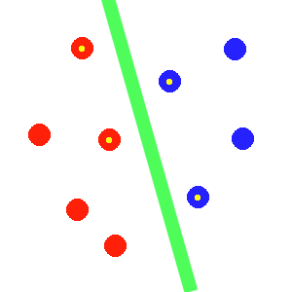
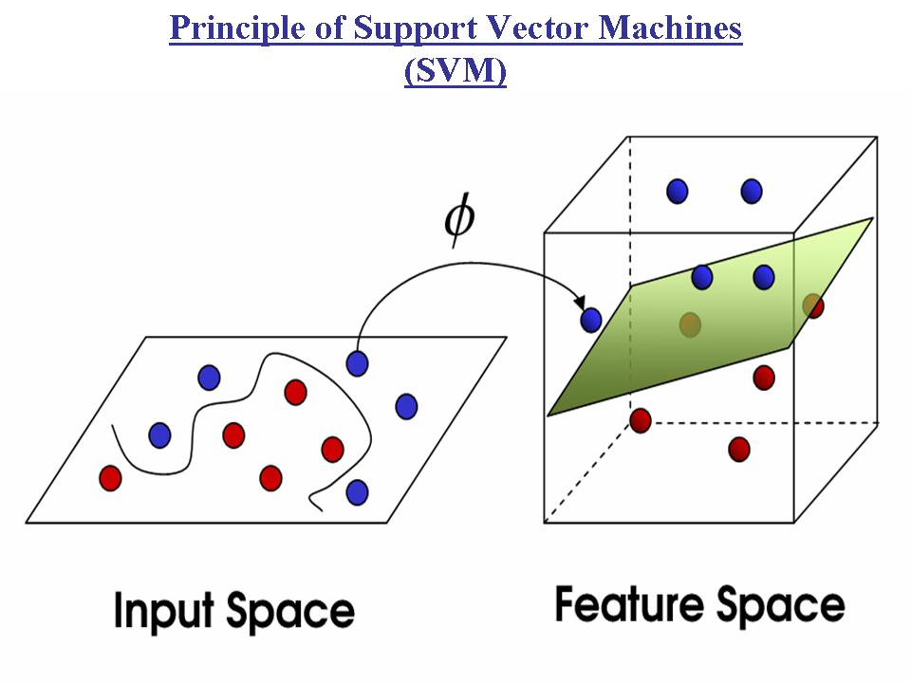
Related Work
SVM
(Support Vector Machine)
(DeVel 2000; Teng et al. 2004)
  Accurate, because considers all features at every step.
  Pitfall: A black box. Difficult to present evidence to justify the conclusion of authorship.
Source: http://www.imtech.res.in/raghava/rbpred/svm.jpg

Slide 11
Our Approach:
AuthorMiner
E-mails E₁
E-mails E₂
E-mails E₃
Phase 1: Mining frequent patterns:
Frequent Pattern:
A set of feature items that frequently occur together in set of e-mails E_{i}.
Mining
Mining
Mining
Frequent Patterns
FP(E₁)
Frequent Patterns
FP(E₂)
Frequent Patterns
FP(E₃)
Frequent patterns (a.k.a. frequent itemset)
Foundation for many data mining tasks
Capture combination of items that frequently occurs together
Useful in marketing, catalogue design, web log, bioinformatics, materials engineering

Slide 12
Our Approach:
AuthorMiner
E-mails E₁
E-mails E₂
E-mails E₃
Mining
Mining
Mining
Frequent Patterns
FP(E₁)
Frequent Patterns
FP(E₂)
Frequent Patterns
FP(E₃)
Phase 2: Filter out the common frequent patterns among suspects.

Slide 13
Our Approach:
AuthorMiner
E-mails E₁
E-mails E₂
E-mails E₃
Mining
Mining
Mining
Frequent Patterns
FP(E₁)
Frequent Patterns
FP(E₂)
Frequent Patterns
FP(E₃)
Phase 2: Filter out the common frequent patterns among suspects.
Write-Print
WP(E₁)
Write-Print
WP(E₂)
Write-Print
WP(E₃)

Slide 14
Our Approach:
AuthorMiner
E-mails E₁
E-mails E₂
E-mails E₃
Mining
Mining
Mining
Frequent Patterns
FP(E₁)
Frequent Patterns
FP(E₂)
Frequent Patterns
FP(E₃)
Write-Print
WP(E₁)
Write-Print
WP(E₂)
Write-Print
WP(E₃)
Phase 3: Match e-mail μ with write-print.

Slide 15
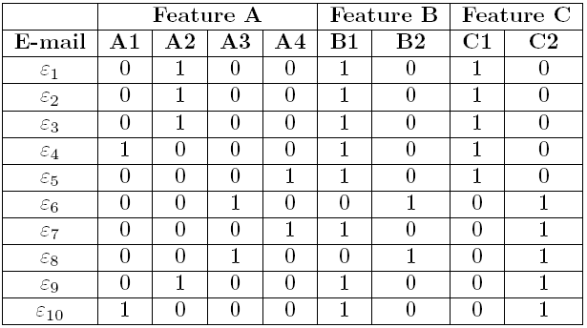
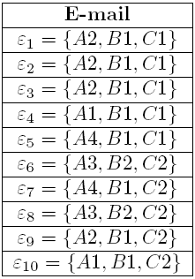
Phase 0: Preprocessing
Has signature?

Slide 16
Phase 1: Mining Frequent Patterns
An e-mail ε contains a pattern F if F ⊆ ε.
The support of a pattern F, support(F|E_{i}), is the percentage of e-mails in E_{i} that contains F.
F is frequent if its support(F|E_{i}) > min_sup.
  Suppose min_sup = 0.3.
  {A2,B1} is a frequent pattern because it has support = 4.

Slide 17
Phase 1: Mining Frequent Patterns
Apriori property: All nonempty subsets of a frequent pattern must also be frequent.
  If a pattern is not frequent, its superset is not frequent.
Suppose min_sup = 0.3
C₁ = {A1,A2,A3,A4,B1,B2,C1,C2}
L₁ = {A2, B1,C1,C2}
C₂ = {A2B1,A2C1,A2C1,A2C2,B1C1, B1C2,C1C2}
L₂ = {A2B1,A2C1,B1C1,B1C2}
C₂ = {A2B1C1,B1C1C2}
L₃ = {A2B1C1}

Slide 18
Phase 2: Filtering Common Patterns
Before filtering:
FP(E₁) = {A2,B1,C1,C2,A2B1,A2C1,B1C1,B1C2,A2B1C1}
FP(E₂) = {A1,B1,C1,A1B1,A1C1,B1C1,A1B1C1}
FP(E₃) = {A2,B1,C2,A2B1,A2C2}
After filtering:
WP(E₁) = {A2, A2C1,B1C2,A2B1C1}
WP(E₂) = {A1, A1B1,A1C1,A1B1C1}
WP(E₃) = {A2, A2C2}

Slide 19

Phase 3: Matching Write-Print
Intuitively, a write-print WP(E_{i}) is similar to μ if many frequent patterns in WP(E_{i}) matches the style in μ.
Score function that quantifies the similarity between the malicious e-mail μ and a write-print WP(E_{i}).
The suspect having the write-print with the highest score is the author of the malicious e-mail μ.

Slide 20
Major Features of Our Approach
Justifiable evidence
  Guarantee the identified patterns are frequent in the e-mails of one suspect only, and are not frequent in others' emails
Combination of features (frequent pattern)
  Capture the combination of multiple features (cf. decision tree)
Flexible writing styles
  Can adopt any type of commonly used writing style features
  Unimportant features will be ignored.

Slide 21
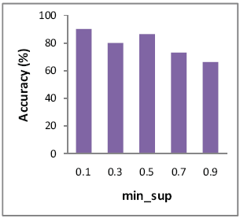
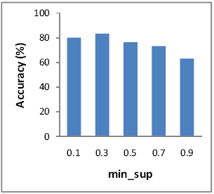
Experimental Evaluation
Dataset: Enron E-mail
2/3 for training. 1/3 for testing. 10-fold cross validation
Number of suspects = 6 Number of suspects = 10

Slide 22
Experimental Evaluation
Example of write-print:
{regrds, u}
{regrds, capital letter per sentence = 0.02}
{regrds, u, capital letter per sentence = 0.02}

Slide 23
Conclusion
Most previous contributions focused on improving the classification accuracy of authorship identification, but only very few of them study how to gather strong evidence.
We introduce a novel approach of authorship attribution and formulate a new notion of write-print based on the concept of frequent patterns.

Slide 24
References
J. Burrows. An ocean where each kind: statistical analysis and some major determinants of literary style. Computers and the Humanities August 1989;23(4–5):309–21.
O. De Vel. Mining e-mail authorship. paper presented at the workshop on text mining. In ACM International Conference on Knowledge Discovery and Data Mining (KDD), 2000.
B.C.M. Fung, K. Wang, M. Ester. Hierarchical document clustering using frequent itemsets. In: Proceedings of the third SIAM international conference on data mining (SDM); May 2003. p. 59–70
I. Holmes. The evolution of stylometry in humanities. Literary and Linguistic Computing 1998;13(3):111–7.

Slide 25
References
I. Holmes I, R.S. Forsyth. The federalist revisited: new directions in authorship attribution. Literary and Linguistic Computing 1995;10(2):111–27.
G.-F. Teng, M.-S. Lai, J.-B. Ma, and Y. Li. E-mail authorship mining based on svm for computer forensic. In In Proc. of the 3rd International Conference on Machine Learning and Cyhemetics, Shanghai, China, August 2004.
J. Tweedie, R. H. Baayen. How variable may a constant be? Measures of lexical richness in perspective. Computers and the Humanities 1998;32:323–52.
G. Yule. On sentence length as a statistical characteristic of style in prose. Biometrika 1938;30:363–90.

Slide 26
References
G. Yule. The statistical study of literary vocabulary. Cambridge, UK: Cambridge University Press; 1944.
R. Zheng, J. Li, H.Chen, Z. Huang. A framework for authorship identification of online messages: writing-style features and classification techniques. Journal of the American Society for Information Science and Technology 2006;57(3):378–93.

