Slide 1

Training Dynamics of a 1.7B LLaMa Model: A Data-Efficient Approach
Miles Q. Li, Benjamin C. M. Fung, Shih-Chia Huang
McGill University, National Taipei University of Technology
IJCNN 2025

Slide 2




The Challenge of LLM Training
Complex Process
Multiple Factors
Our Goal
LLMs show incredible capabilities, but pretraining is complex
Architecture, data quality, training continuity, hardware
Share experiences from pretraining DMaS-LLaMa-Lite

Slide 3










Our Contribution: A Multi-Faceted Analysis
Training Dynamics
Validation loss and benchmarks over 40,000+ steps
Practical Lessons
Optimizer states, hardware transitions impact
High-Quality Data
FineWeb-Edu subset enables performance with fewer tokens
Qualitative Observations
From incoherent to fluent, contextual outputs
Instruction Tuning
Parameter-efficient finetuning, behavioral changes

Slide 4
DMaS-LLaMa-Lite: Model & Training Setup
Model Architecture
Training Data
Hardware & Optimizer
1.7B parameters, LLaMa-style
FineWeb-Edu subset - 20B tokens
1-2 RTX A6000 GPUs
36 layers, hidden size 2048, 32 attention heads
High-quality, educational content
AdamW with cosine decay
Meticulous filtering, deduplication
Max LR: 6e-4, Min LR: 6e-5
GPT-2 tokenizer

Slide 5

The Cornerstone: High-Quality Training Data
Dataset Sourcing
Subset of HuggingFaceFW/fineweb-edu 100BT
Derived from 15-trillion-token FineWeb
Selection Process
Classifier trained on Llama-3-70B-Instruct annotations
Prioritizes grade to middle-school knowledge
Quality Control
Custom filters for document structure
Per-snapshot MinHash deduplication
Heuristic filters remove low-quality content

Slide 6
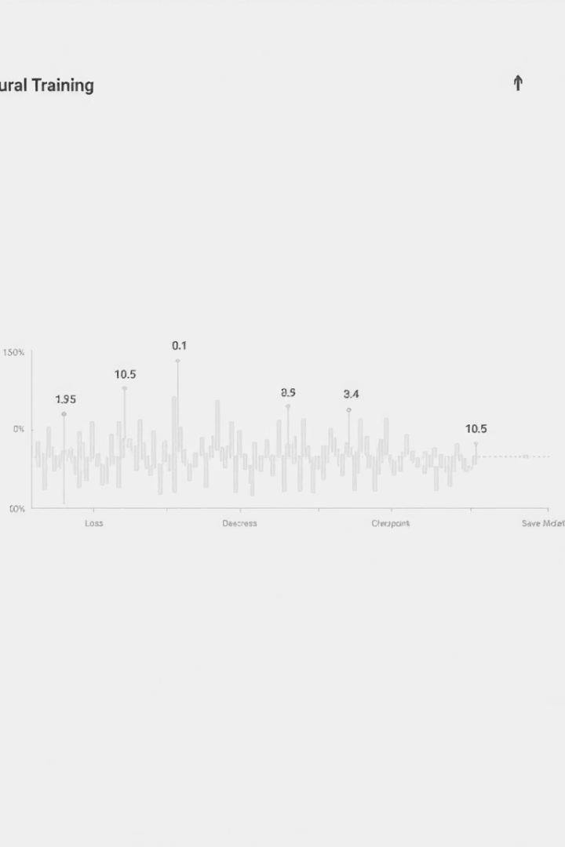



Training Procedure Details & Checkpointing
Training Volume
Over 40,000 steps total
0.5 million tokens processed per step
Checkpointing Strategy
Saved every 100 steps
Enables fine-grained trajectory analysis
Hardware Transitions
Switches between single and dual RTX A6000 GPUs
PyTorch DDP for efficient parallelism

Slide 7




The Peril of Ignoring Optimizer States
The Problem
Loading only model weights during resumption
The Consequences
Abrupt loss spikes
Degraded benchmark performance
The Cost
Wasted compute resources during recovery
The Solution
Always restore full optimizer states
Robust checkpointing scripts essential

Slide 8
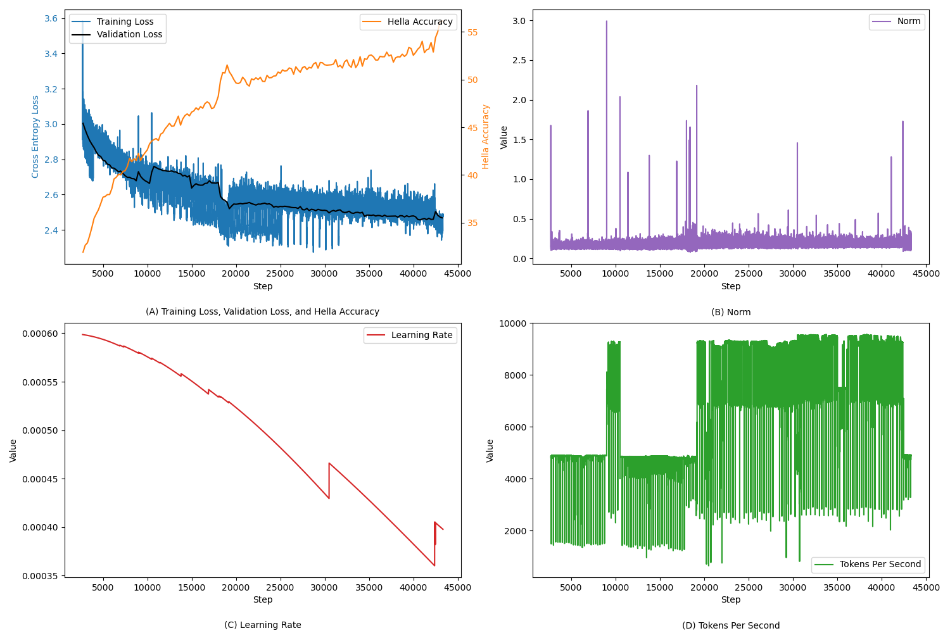
Pretraining Dynamics: Quantitative View
Figure 1 Training logs visualizing training and validation loss, Hella accuracy, learning rate decay, norm behavior, and tokens processed per second over the course of 40,000+ steps

Slide 9
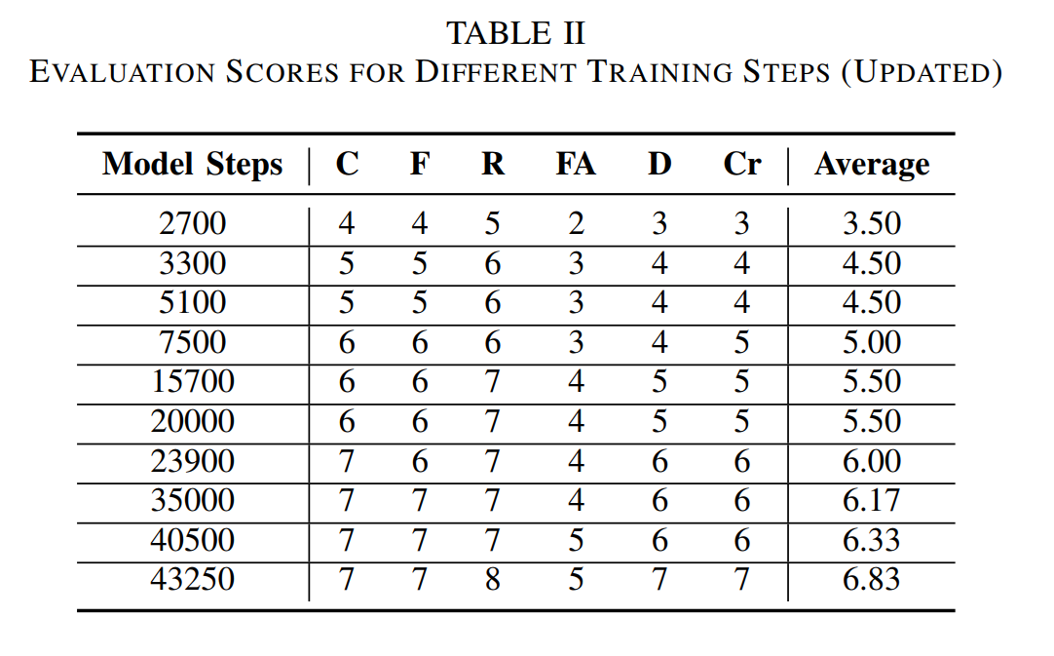
Pretraining Dynamics: Qualitative Evolution
C – Coherence
F – Fluency and Grammar
R – Relevance to Prompt
FA – Factual Accuracy
D – Depth and Completeness
Cr – Creativity

Slide 10
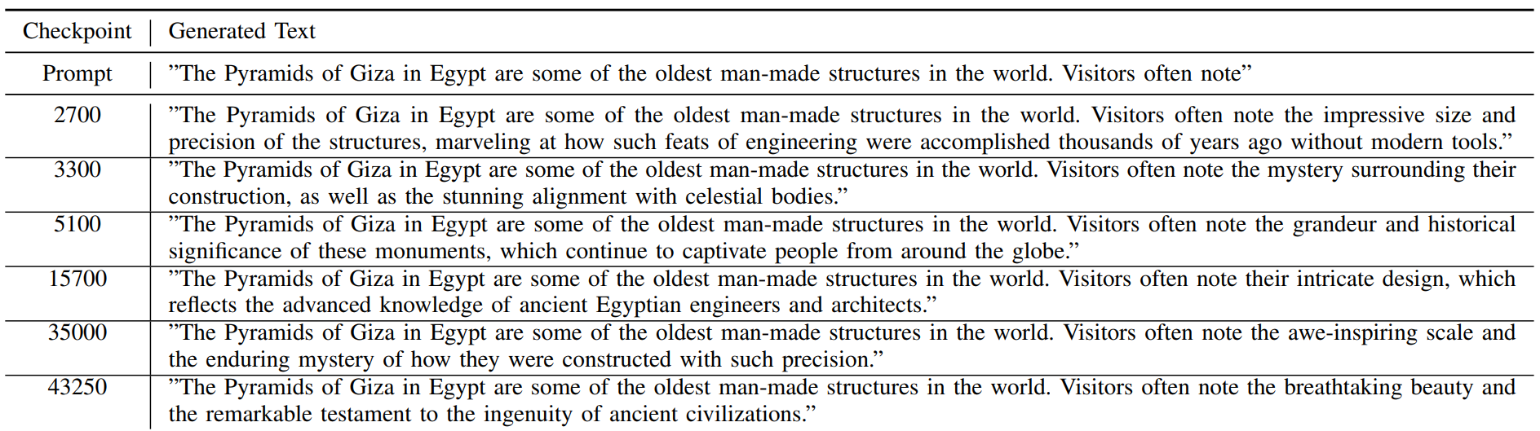
Pretraining Dynamics: Qualitative Evolution
Part of Table III

Slide 11
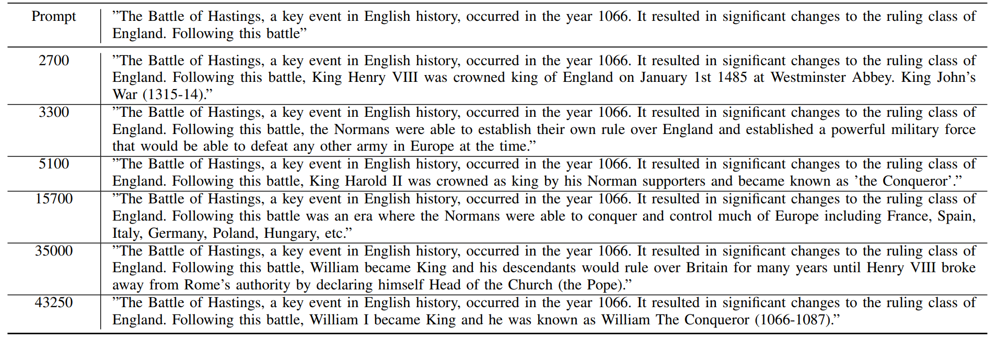
Pretraining Dynamics: Qualitative Evolution
Part of Table III

Slide 12
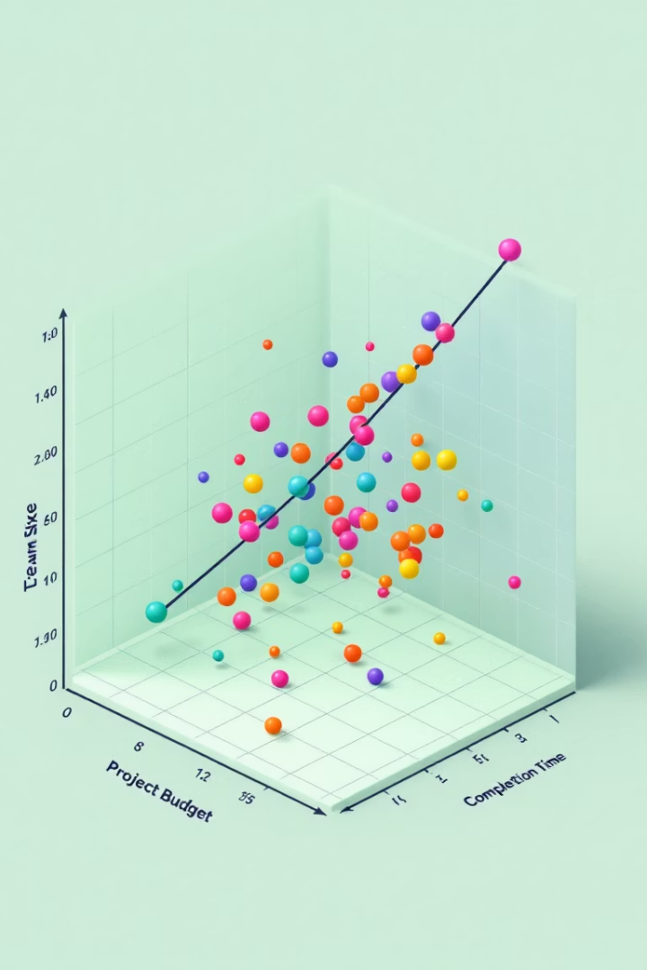
Metric Correlations with Quality
0.928
-0.945
Steps Correlation
Loss Correlation
More training, better quality
Lower loss, better quality
0.963
Hellaswag Correlation
Strongest predictor of quality

Slide 13
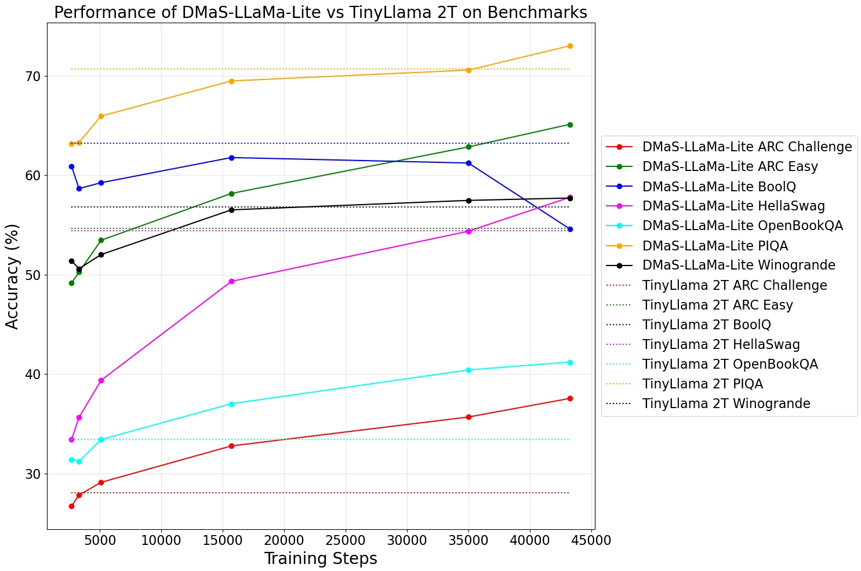
Impact of High-Quality Data: Comparison
Figure 1 Training logs visualizing training and validation loss, Hella accuracy, learning rate decay, norm behavior, and tokens processed per second over the course of 40,000+ steps

Slide 14

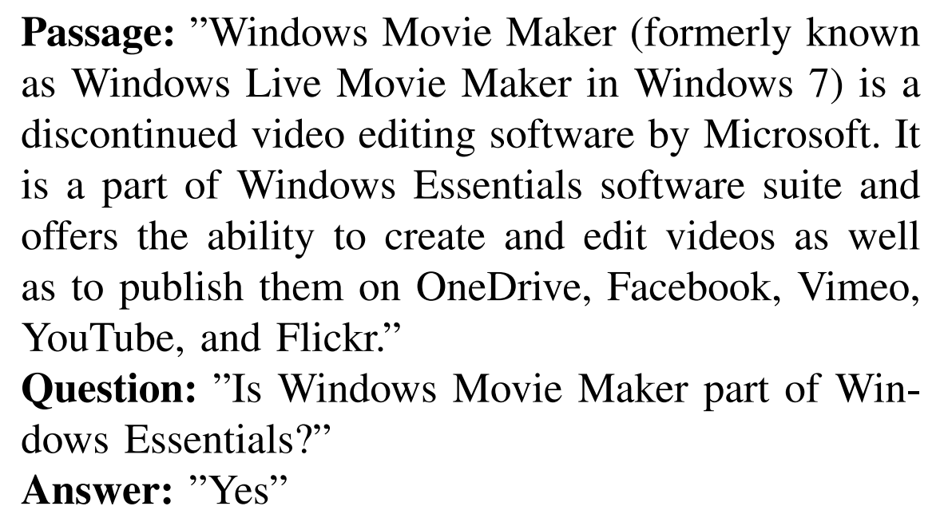
Example

Slide 15




BoolQ Reasoning Limitations
Question Format
Yes/no answers only
Reasoning Need
Requires inferential steps
Missing Chain-of-Thought
Can't show reasoning work
Solution
Specialized training needed

Slide 16
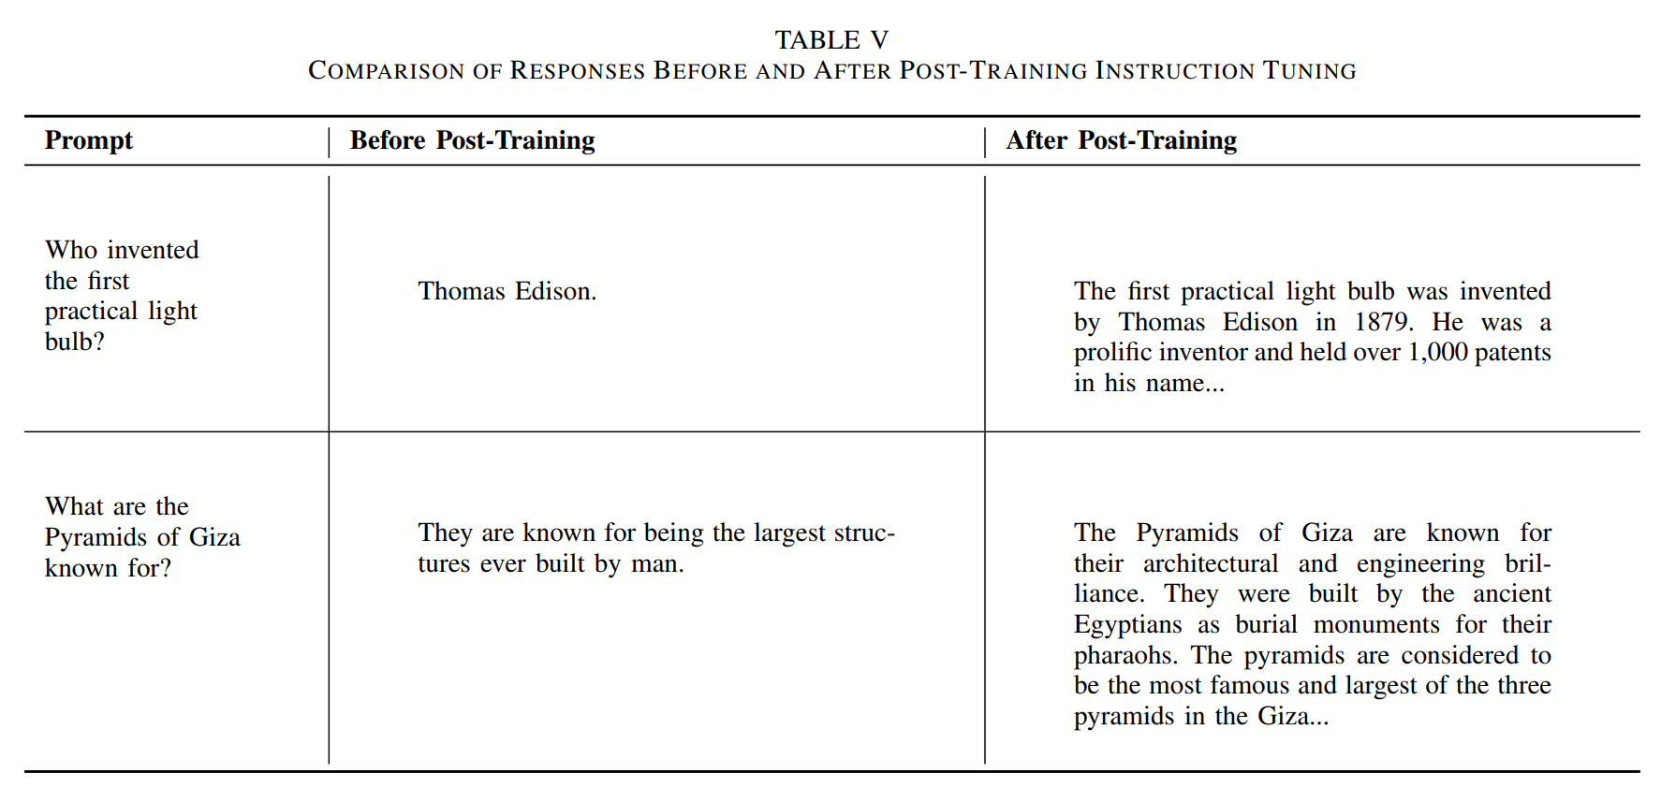
Post-Training Instruction Tuning
Starting Point
Best pretrained checkpoint (43,500 steps)
Method
LoRA adapters (rank 128), only ~400 steps
Results
More detailed, conversational responses

Slide 17

Tokenizer Behavior
1
ASSISTANT:
["ASS", "IST", "ANT", ":"]
2
ASSISTANT:
["ASS", "IST", "ANT", ":", "Ġ"]
3
Result
Different probability distribution

Slide 18






Key Takeaways & Conclusion
Data Efficiency Works
Quality trumps quantity
Practical Lessons Matter
Optimizer state restoration is critical
Persistent Challenges
Factual accuracy needs targeted approaches

Slide 19
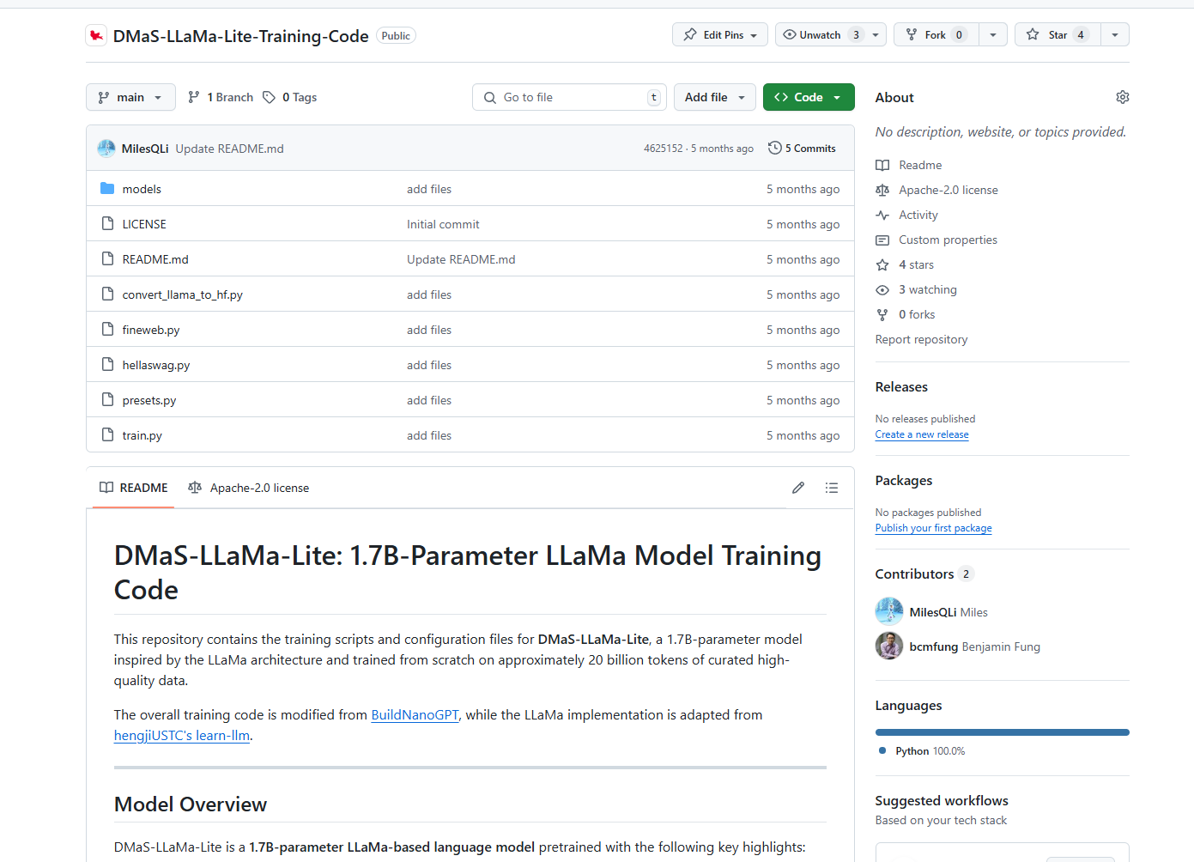
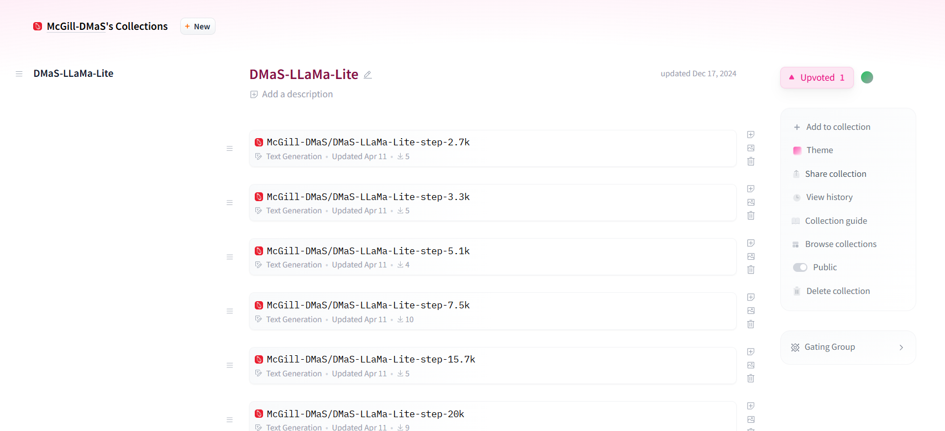
Thank You & Resources
Training code:
https://github.com/McGill-DMaS/DMaS-LLaMa-Lite-Training-Code
Intermediate model checkpoints available:
https://huggingface.co/collections/McGill-DMaS/dmas-llama-lite-6761d97ba903f82341954ceb

