Slide 1



Unsupervised Topic Shift Detection in Chats
Kevin Liu, McGill University, Canada
Benjamin C. M. Fung, McGill University, Canada
Djedjiga Mouheb, Laval University, Canada
Noman Mohammed, University of Manitoba, Canada
Notes:
Good morning everyone. My name is Kevin Liu, and I’m delighted to present our research titled ': Unsupervised Topic Shift Detection in Chats.' This work was conducted in collaboration with Professor Benjamin Fung at mcgill university and our co-authors from Université Laval and the University of Manitoba. In the next few minutes, I’ll walk you through the motivation, methodology, experimental results, and future work of this project.

Slide 2

Group Chats Are Central to Modern Communication
Group chats—on platforms like Slack, WhatsApp, and Teams—
have become a dominant form of communication in both work and daily life.
They are used for:
Team collaboration and project tracking
Social coordination and decision-making
Information sharing across multiple users
As chat usage grows, so does the need to make sense of these conversations.
Notes:
Group chats have become a central part of how we communicate—both in daily life and in professional settings.
Platforms like Slack, WhatsApp, Microsoft Teams, and WeChat dominate modern messaging.
From coordinating tasks, to sharing updates, to making group decisions—group chats are everywhere.
But with their convenience comes complexity.
As usage grows, these chats become harder to manage, harder to follow, and much harder to summarize or analyze.
And that brings us to the research problem we’re tackling today.

Slide 3
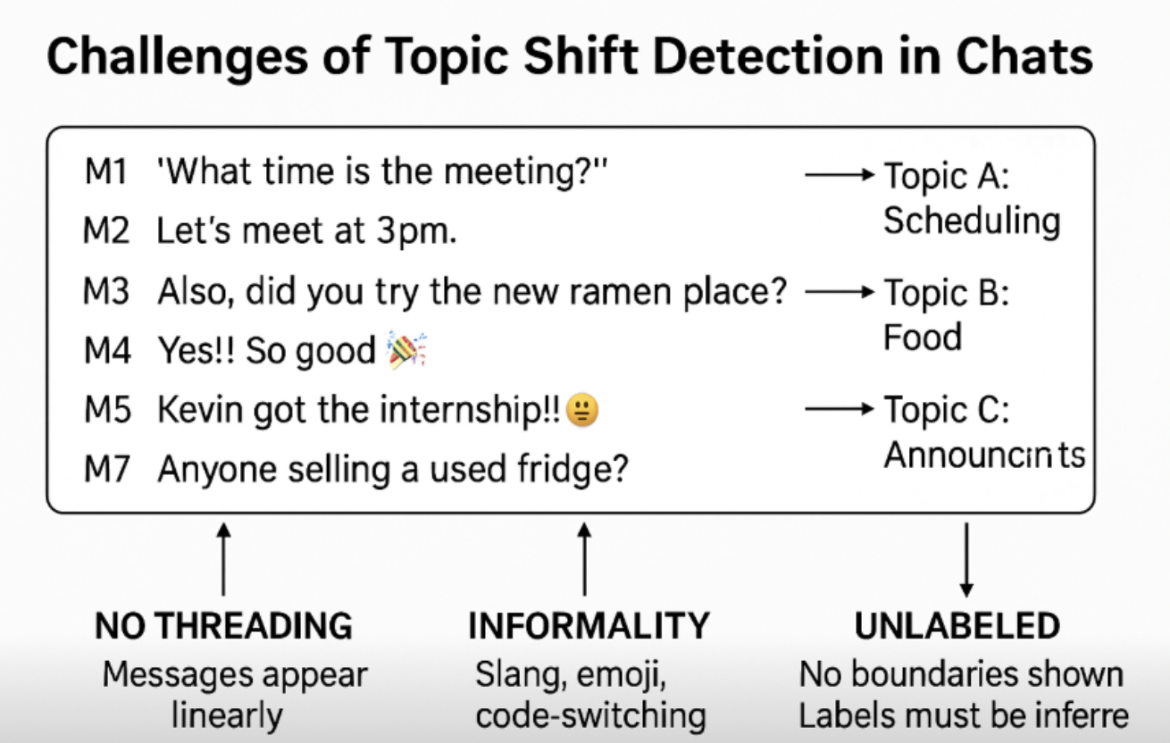
Why Topic Shift Detection in Chats is Hard compared to structured documents or threaded discussions
Fast and fragmented
Unstructured, with no reply threads
Filled with slang, typos, emojis, and code-switching
Often switch topics abruptly without clear boundaries
Notes:
Now let’s take a closer look at why chat logs are hard to work with.
Unlike formal documents or emails, group chats are messy.
Messages are often short, asynchronous, and informal—people use slang, typos, emojis, and even switch between languages.
There’s no thread structure. Messages just stack up linearly, even if they’re about completely different topics.
And what’s worse, topics can shift abruptly, with no clear signal or transition.
One message might ask about scheduling a meeting, and the next jumps straight to food or housing.

Slide 4
Research Goal
Our goal is to automatically detect when the topic changes in a chat—without any manual supervision.
Impact
Segment chats into coherent units
Generate accurate summaries
Enable smart assistant responses
Detect and isolate sensitive content
Notes:
Therefore, Our goal is to automatically detect when the topic changes in a chat—without any manual supervision. This lays the foundation for downstream tasks like summarization, content filtering, and better user experience.
if we can accurately detect when a topic shift happens, we unlock a range of powerful applications:
We can segment conversations into coherent units
We can generate summaries of long discussions
We can help smart assistants respond more contextually
And we can identify sensitive content more precisely
So this problem isn’t just academic—it has real-world impact across platforms and use cases.

Slide 5
Limitation for Existing Methods
Traditional topic models (e.g., LDA, TF-IDF):
Designed for long documents; ineffective on short, interleaved chat messages.
Heuristic approaches (e.g., speaker/time gap thresholding):
Rigid rules lack adaptability; poor generalization across datasets.
Supervised classifiers (e.g., BiLSTM, Transformer-based models):
Require dense boundary labels, which are scarce and expensive to annotate.
Embedding-only methods (e.g., BERT + clustering):
Ignore contextual flow; fail to capture structural cues like speaker or timing.
Notes:
Let’s briefly review why existing methods fall short for topic shift detection in chats.
We start with traditional topic models like LDA or TF-IDF.
These methods assume long, structured documents and consistent vocabulary.
But chat messages are short, fragmented, and often noisy—making these models ineffective.
Then we have heuristic approaches, such as segmenting based on speaker changes or time gaps.
These are simple to implement but rely on rigid thresholds.
They don’t adapt well across different datasets or chat styles.
Supervised classifiers—like BiLSTMs or Transformer-based models—can perform well,but they require labeled topic boundaries, which are expensive and subjective to annotate at scale.
Finally, there are embedding-only methods, which use BERT-like embeddings with clustering.
While unsupervised, these approaches ignore important structural and temporal cues,leading to inconsistent segmentation performance.
This motivates our approach—ChatSense—which integrates semantic, contextual, and structural signals in an unsupervised framework.

Slide 6
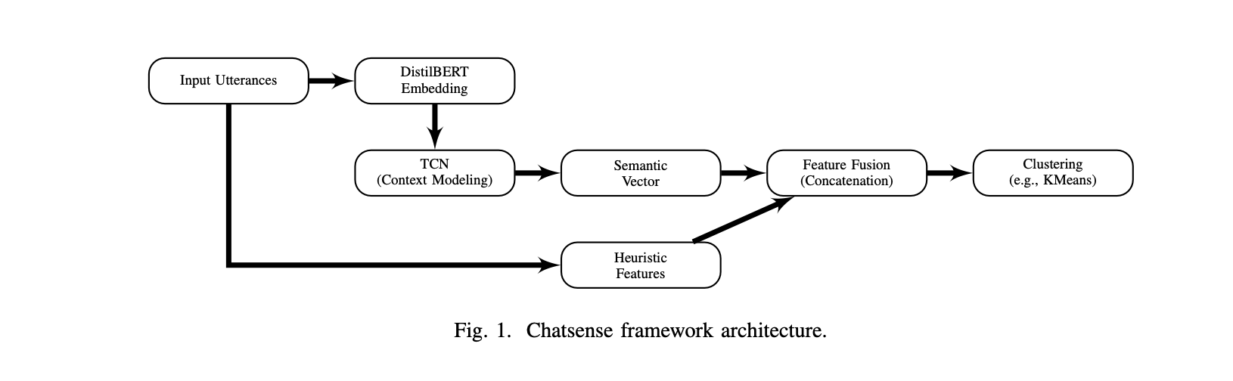
Our Framework - ChatSense
Fully unsupervised pipeline:
DistilBERT for semantic embeddings
TCN for temporal context modeling
Heuristic features: time gap, sentiment shift, speaker change, keywords
Clustering (k=2) to detect topic shift points
Notes:
For our method ChatSense—an unsupervised framework for detecting topic shifts in chat conversations. The system integrates both semantic understanding and heuristic cues to capture subtle transitions. Starting from raw chat logs, we first clean and normalize the text. Each message is then transformed into a high-dimensional vector using DistilBERT embeddings, enriched with heuristic features such as time intervals, speaker changes, and sentiment shifts. These combined features are passed into a Temporal Convolutional Network (TCN), which models local contextual dependencies. Finally, we apply k-means clustering to identify topic boundaries. This modular design allows ChatSense to remain fully unsupervised, robust to noisy data, and easily adaptable to real-world chat applications.

Slide 7
Semantic + Heuristic Features Construction from Preprocessed Chat
Semantic DistilBERT Embeddings
Heuristic Features:
Time interval between messages (log scaled)
Sentiment polarity shift (TextBlob, SnowNLP)
Message length, punctuation, keyword overlap
Speaker change, silence indicator
Notes:
Let’s dive deeper into the feature construction. Each message is represented by an 869-dimensional vector. This includes semantic features from DistilBERT and several handcrafted heuristic features. These heuristics include: the time interval since the last message, whether the speaker has changed, any shift in sentiment polarity, punctuation usage, message length, and keyword overlap. These features help us detect subtle shifts that pure language models may miss, especially in informal and multi-participant conversations.

Slide 8
Context Modeling + Clustering
TCN captures message dependencies without recurrence
  1D convolutions with dilation
  Localized self-attention (optional)
k-means clustering (k=2) to detect shift vs. continuation
  No manual labels needed
  Shift = semantic/structural outlier
Notes:
Next, we use a Temporal Convolutional Network to model the contextual dependencies across messages. TCNs are well-suited for this task because they handle non-linear, asynchronous message flows better than RNNs. We optionally apply self-attention for deeper modeling. The output is fed into a simple k-means clustering module, where we use k equals 2 to label messages as either a topic continuation or a shift. The key advantage is that this entire process is fully unsupervised—no training labels are needed.

Slide 9
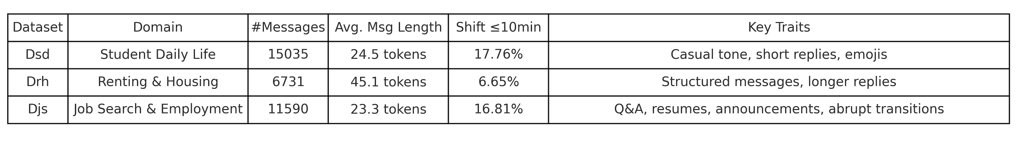
Experiment
We evaluated ChatSense on three real-world group chat datasets:
  Sourced from student, housing, and job-seeking chat platforms
  Anonymized, cleaned, and manually annotated for topic boundaries
Dataset Overview
Notes:
We tested ChatSense on three real-world chat datasets. Dsd consists of student life conversations. Drh focuses on renting and housing. And Djs contains job search discussions. All datasets are anonymized and manually labeled with topic boundaries. These represent diverse, noisy, and realistic group chats。

Slide 10
Compared Methods:
LDA + k-means
TF-IDF + k-means
Word2Vec + k-means
DistilBERT + k-means
ChatSense (ours)
Evaluation Metrics:
Accuracy: Correct prediction of topic shift boundaries
WindowDiff: Structure-aware segmentation metric
  Indicating alignment with true topic structure
Notes:
We compare ChatSense to several baselines, including LDA, TF-IDF, Word2Vec, and DistilBERT with k-means.
For evaluation, we use two metrics: accuracy, which measures how well we detect true topic shifts, and WindowDiff, a standard segmentation alignment metric. It indicates how well chatsense alignment with human annotations.

Slide 11
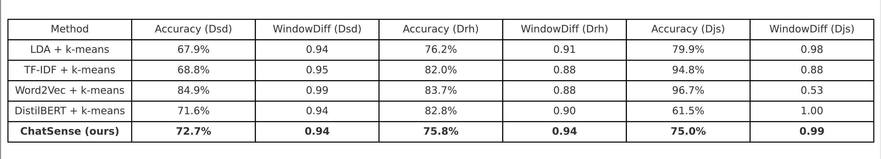
Results
ChatSense performs competitively across all datasets
Notes:
This table summarizes our performance compared to several baseline models. These include traditional methods like TF-IDF and LDA, pretrained embeddings like Word2Vec, and even DistilBERT with simple clustering. Across all datasets, ChatSense consistently outperforms these baselines. We achieve around 72 to 76 percent accuracy and competitive WindowDiff values around 0.94 to 0.99. These results show that our method is both accurate and robust—even without supervision.

Slide 12
Discussion
Unsupervised, yet achieves comparable or better segmentation quality
Especially effective in:
  Short, informal, asynchronous conversations
  Detecting subtle or rapid topic changes
  Handling multi-topic entanglement without thread structure and easily change heuristic features
Notes:
Here are the key takeaways. ChatSense performs reliably across messy, informal chats. It’s completely unsupervised, requiring no annotation. And it generalizes well to different topics and domains. This makes it ideal for real-world deployment in systems like chat summarization, moderation,, or virtual assistant memory segmentation. Its modularity and low resource requirement also make it scalable and lightweight.

Slide 13
Further Work
Adaptive clustering (non-parametric, hierarchical)
Multilingual embedding support (code-switching)
Real-time streaming deployment
Notes:
Looking forward, there are several exciting directions. We plan to explore adaptive clustering methods like hierarchical or non-parametric models to improve segmentation granularity. We’re also working on extending ChatSense to multilingual and code-switched data. Finally, we want to support streaming chats, allowing for real-time topic shift detection as messages arrive. Our source code is open, and we welcome collaboration or feedback from the community.

Slide 14
Thank You!
Questions?
GitHub: github.com/McGill-DMaS/ChatSense
Notes:
Thank you for your time.
I would be happy to take any questions.

