Slide 1
Anonymizing Healthcare Data: A Case Study on the Blood Transfusion Service
Noman Mohammed
Concordia University
Montreal, QC, Canada
no_moham@ciise.concordia.ca
Benjamin C.M. Fung
Concordia University
Montreal, QC, Canada
fung@ciise.concordia.ca
Patrick C. K. Hung
UOIT
Oshawa, ON, Canada
patrick.hung@uoit.ca
Cheuk-kwong Lee
Hong Kong Red Cross
Blood Transfusion Service
Kowloon, Hong Kong
ckleea@ha.org.hk
KDD 2009

Slide 2
Outline
Motivation & background
Privacy threats & information needs
Challenges
LKC-privacy model
Experimental results
Related work
Conclusions

Slide 3
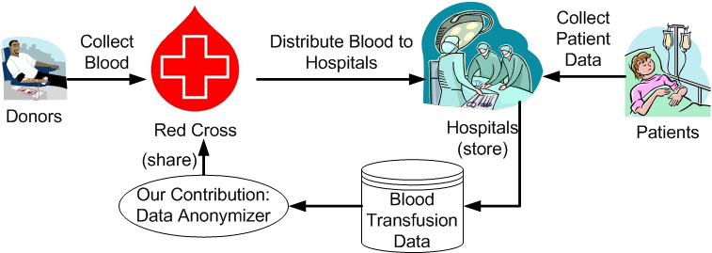
Motivation & background
Organization: Hong Kong Red Cross Blood Transfusion Service and Hospital Authority

Slide 4
Data flow in Hong Kong Red Cross

Slide 5


Healthcare IT Policies
Hong Kong Personal Data (Privacy) Ordinance
Personal Information Protection and Electronic Documents Act (PIPEDA)
Underlying Principles
  Principle 1: Purpose and manner of collection
  Principle 2: Accuracy and duration of retention
  Principle 3: Use of personal data
  Principle 4: Security of Personal Data
  Principle 5: Information to be Generally Available
  Principle 6 : Access to Personal Data

Slide 6
Contributions
Very successful showcase of privacy-preserving technology
Proposed LKC-privacy model for anonymizing healthcare data
Provided an algorithm to satisfy both privacy and information requirement
Will benefit similar challenges in information sharing

Slide 7
Outline
Motivation & background
Privacy threats & information needs
Challenges
LKC-privacy model
Experimental results
Related work
Conclusions

Slide 8
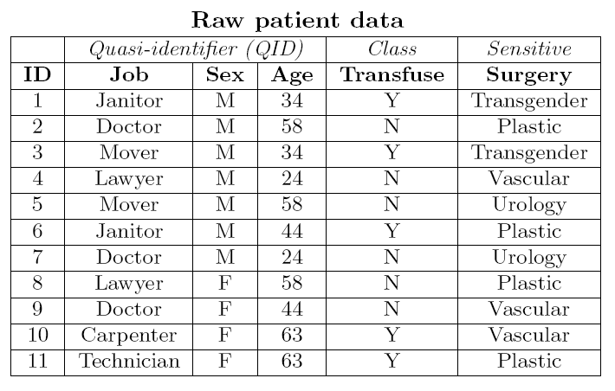
Privacy threats
Identity Linkage: takes place when the number of records containing same QID values is small or unique.
Data recipients
Adversary
Knowledge: Mover, age 34
Identity Linkage Attack

Slide 9
Privacy threats
Identity Linkage: takes place when the number of records that contain the known pair sequence is small or unique.
Attribute Linkage: takes place when the attacker can infer the value of the sensitive attribute with a higher confidence.
Adversary
Knowledge: Male, age 34
Attribute Linkage Attack

Slide 10
Information needs
Two types of data analysis
  Classification model on blood transfusion data
  Some general count statistics
why does not release a classifier or some statistical information?
  no expertise and interest ….
  impractical to continuously request….
  much better flexibility to perform….

Slide 11
Outline
Motivation & background
Privacy threats & information needs
Challenges
LKC-privacy model
Experimental results
Related work
Conclusions

Slide 12
Challenges
Why not use the existing techniques ?
The blood transfusion data is high-dimensional
It suffers from the “curse of dimensionality”
Our experiments also confirm this reality

Slide 13
Curse of High-dimensionality
ID | Job | Sex | Age | Education | Sensitive Attribute
1 | Janitor | M | 25 | Primary | …
2 | Janitor | M | 40 | Primary | …
3 | Janitor | F | 25 | Secondary | …
4 | Janitor | F | 40 | Secondary | …
5 | Mover | M | 25 | Secondary | …
6 | Mover | F | 40 | Primary | …
7 | Mover | M | 40 | Secondary | …
8 | Mover | F | 25 | Primary | …
K=2
QID = {Job, Sex, Age, Education}
Job
ANY
Sex
ANY
Age
ANY
Education
ANY
Mover
Janitor
Male
Female
25
40
Primary
Secondary

Slide 14
Curse of High-dimensionality
ID | Job | Sex | Age | Education | Sensitive Attribute
1 | Any | M | 25 | Primary | …
2 | Any | M | 40 | Primary | …
3 | Any | F | 25 | Secondary | …
4 | Any | F | 40 | Secondary | …
5 | Any | M | 25 | Secondary | …
6 | Any | F | 40 | Primary | …
7 | Any | M | 40 | Secondary | …
8 | Any | F | 25 | Primary | …
K=2
QID = {Job, Sex, Age, Education}
Job
ANY
Sex
ANY
Age
ANY
Education
ANY
Mover
Janitor
Male
Female
25
40
Primary
Secondary

Slide 15
Curse of High-dimensionality
15
ID | Job | Sex | Age | Education | Sensitive Attribute
1 | Any | Any | 25 | Primary | …
2 | Any | Any | 40 | Primary | …
3 | Any | Any | 25 | Secondary | …
4 | Any | Any | 40 | Secondary | …
5 | Any | Any | 25 | Secondary | …
6 | Any | Any | 40 | Primary | …
7 | Any | Any | 40 | Secondary | …
8 | Any | Any | 25 | Primary | …
K=2
QID = {Job, Sex, Age, Education}
What if we have 20 attributes ?
What if we have 40 attributes ?
Job
ANY
Sex
ANY
Age
ANY
Education
ANY
Mover
Janitor
Male
Female
25
40
Primary
Secondary

Slide 16
Outline
Motivation & background
Privacy threats & information needs
Challenges
LKC-privacy model
Experimental results
Related work
Conclusions

Slide 17
LKC-privacy
ID | Job | Sex | Age | Education | Surgery
1 | Janitor | M | 25 | Primary | Plastic
2 | Janitor | M | 40 | Primary | Transgender
3 | Janitor | F | 25 | Secondary | Transgender
4 | Janitor | F | 40 | Secondary | Vascular
5 | Mover | M | 25 | Secondary | Urology
6 | Mover | F | 40 | Primary | Plastic
7 | Mover | M | 40 | Secondary | Vascular
8 | Mover | F | 25 | Primary | Urology
L=2, K=2, C=50%
QID1=<Job, Sex>
QID2=<Job, Age>
QID3=<Job, Edu>
QID4=<Sex, Age>
QID5=<Sex, Edu>
QID6=<Age, Edu>
Is it possible for an adversary to acquire all the information about a target victirm?
Job
ANY
Sex
ANY
Age
ANY
Education
ANY
Mover
Janitor
Male
Female
25
40
Primary
Secondary

Slide 18
LKC-privacy
ID | Job | Sex | Age | Education | Surgery
1 | Janitor | M | 25 | Primary | Plastic
2 | Janitor | M | 40 | Primary | Transgender
3 | Janitor | F | 25 | Secondary | Transgender
4 | Janitor | F | 40 | Secondary | Vascular
5 | Mover | M | 25 | Secondary | Urology
6 | Mover | F | 40 | Primary | Plastic
7 | Mover | M | 40 | Secondary | Vascular
8 | Mover | F | 25 | Primary | Urology
L=2, K=2, C=50%
QID1=<Job, Sex>
QID2=<Job, Age>
QID3=<Job, Edu>
QID4=<Sex, Age>
QID5=<Sex, Edu>
QID6=<Age, Edu>
Job
ANY
Sex
ANY
Age
ANY
Education
ANY
Mover
Janitor
Male
Female
25
40
Primary
Secondary

Slide 19
LKC-privacy
ID | Job | Sex | Age | Education | Surgery
1 | Janitor | M | 25 | Primary | Plastic
2 | Janitor | M | 40 | Primary | Transgender
3 | Janitor | F | 25 | Secondary | Transgender
4 | Janitor | F | 40 | Secondary | Vascular
5 | Mover | M | 25 | Secondary | Urology
6 | Mover | F | 40 | Primary | Plastic
7 | Mover | M | 40 | Secondary | Vascular
8 | Mover | F | 25 | Primary | Urology
L=2, K=2, C=50%
QID1=<Job, Sex>
QID2=<Job, Age>
QID3=<Job, Edu>
QID4=<Sex, Age>
QID5=<Sex, Edu>
QID6=<Age, Edu>
Job
ANY
Sex
ANY
Age
ANY
Education
ANY
Mover
Janitor
Male
Female
25
40
Primary
Secondary

Slide 20
LKC-privacy
ID | Job | Sex | Age | Education | Surgery
1 | Janitor | M | 25 | Primary | Plastic
2 | Janitor | M | 40 | Primary | Transgender
3 | Janitor | F | 25 | Secondary | Transgender
4 | Janitor | F | 40 | Secondary | Vascular
5 | Mover | M | 25 | Secondary | Urology
6 | Mover | F | 40 | Primary | Plastic
7 | Mover | M | 40 | Secondary | Vascular
8 | Mover | F | 25 | Primary | Urology
L=2, K=2, C=50%
QID1=<Job, Sex>
QID2=<Job, Age>
QID3=<Job, Edu>
QID4=<Sex, Age>
QID5=<Sex, Edu>
QID6=<Age, Edu>
Job
ANY
Sex
ANY
Age
ANY
Education
ANY
Mover
Janitor
Male
Female
25
40
Primary
Secondary

Slide 21
LKC-privacy
ID | Job | Sex | Age | Education | Surgery
1 | Janitor | M | 25 | Primary | Plastic
2 | Janitor | M | 40 | Primary | Transgender
3 | Janitor | F | 25 | Secondary | Transgender
4 | Janitor | F | 40 | Secondary | Vascular
5 | Mover | M | 25 | Secondary | Urology
6 | Mover | F | 40 | Primary | Plastic
7 | Mover | M | 40 | Secondary | Vascular
8 | Mover | F | 25 | Primary | Urology
L=2, K=2, C=50%
QID1=<Job, Sex>
QID2=<Job, Age>
QID3=<Job, Edu>
QID4=<Sex, Age>
QID5=<Sex, Edu>
QID6=<Age, Edu>
Job
ANY
Sex
ANY
Age
ANY
Education
ANY
Mover
Janitor
Male
Female
25
40
Primary
Secondary

Slide 22
LKC-privacy
ID | Job | Sex | Age | Education | Surgery
1 | Janitor | M | 25 | Primary | Plastic
2 | Janitor | M | 40 | Primary | Transgender
3 | Janitor | F | 25 | Secondary | Transgender
4 | Janitor | F | 40 | Secondary | Vascular
5 | Mover | M | 25 | Secondary | Urology
6 | Mover | F | 40 | Primary | Plastic
7 | Mover | M | 40 | Secondary | Vascular
8 | Mover | F | 25 | Primary | Urology
L=2, K=2, C=50%
QID1=<Job, Sex>
QID2=<Job, Age>
QID3=<Job, Edu>
QID4=<Sex, Age>
QID5=<Sex, Edu>
QID6=<Age, Edu>
Job
ANY
Sex
ANY
Age
ANY
Education
ANY
Mover
Janitor
Male
Female
25
40
Primary
Secondary

Slide 23
LKC-privacy
ID | Job | Sex | Age | Education | Surgery
1 | Janitor | M | 25 | Primary | Plastic
2 | Janitor | M | 40 | Primary | Transgender
3 | Janitor | F | 25 | Secondary | Transgender
4 | Janitor | F | 40 | Secondary | Vascular
5 | Mover | M | 25 | Secondary | Urology
6 | Mover | F | 40 | Primary | Plastic
7 | Mover | M | 40 | Secondary | Vascular
8 | Mover | F | 25 | Primary | Urology
L=2, K=2, C=50%
QID1=<Job, Sex>
QID2=<Job, Age>
QID3=<Job, Edu>
QID4=<Sex, Age>
QID5=<Sex, Edu>
QID6=<Age, Edu>
Job
ANY
Sex
ANY
Age
ANY
Education
ANY
Mover
Janitor
Male
Female
25
40
Primary
Secondary

Slide 24
LKC-privacy
A database, T meets LKC-privacy if and only if |T(qid)|>=K and Pr(s|T(qid))<=C for any given attacker knowledge q, where |q|<=L
  “s” is the sensitive attribute
  “k” is a positive integer
  “qid” to denote adversary’s prior knowledge
  “T(qid)” is the group of records that contains “qid”

Slide 25
LKC-privacy
Some properties of LKC-privacy:
  it only requires a subset of QID attributes to be shared by at least K records
  K-anonymity is a special case of LKC-privacy with L = |QID| and C = 100%
  Confidence bounding is also a special case of LKC-privacy with L = |QID| and K = 1
  (a, k)-anonymity is also a special case of LKC-privacy with L = |QID|, K = k, and C = a

Slide 26
Algorithm for LKC-privacy
We extended the TDS to incorporate LKC-privacy
  B. C. M. Fung, K. Wang, and P. S. Yu. Anonymizing classification data for privacy preservation. In TKDE, 2007.
LKC-privacy model can also be achieved by other algorithms
  R. J. Bayardo and R. Agrawal. Data Privacy Through Optimal k-Anonymization. In ICDE 2005.
  K. LeFevre, D. J. DeWitt, and R. Ramakrishnan. Workload-aware anonymization techniques for large-scale data sets. In TODS, 2008.

Slide 27
Outline
Motivation & background
Privacy threats & information needs
Challenges
LKC-privacy model
Experimental results
Related work
Conclusions

Slide 28
Experimental Evaluation
We employ two real-life datasets
  Blood: is a real-life blood transfusion dataset
    41 attributes are QID attributes
    Blood Group represents the Class attribute (8 values)
    Diagnosis Codes represents sensitive attribute (15 values)
    10,000 blood transfusion records in 2008.
  Adult: is a Census data (from UCI repository)
    6 continuous attributes.
    8 categorical attributes.
    45,222 census records

Slide 29
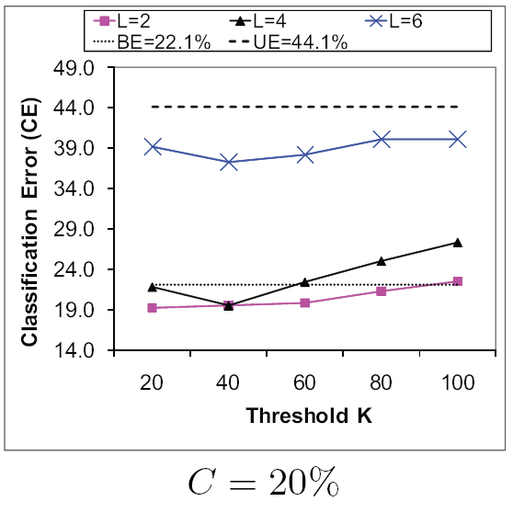
Data Utility
Blood dataset

Slide 30
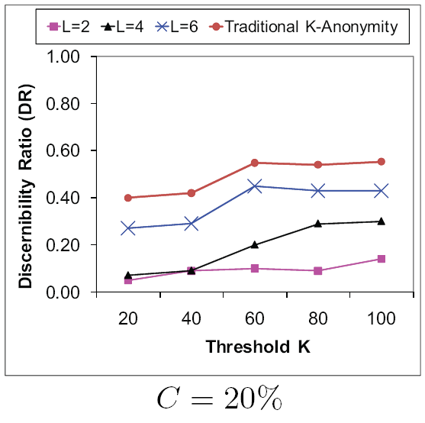
Data Utility
Blood dataset

Slide 31
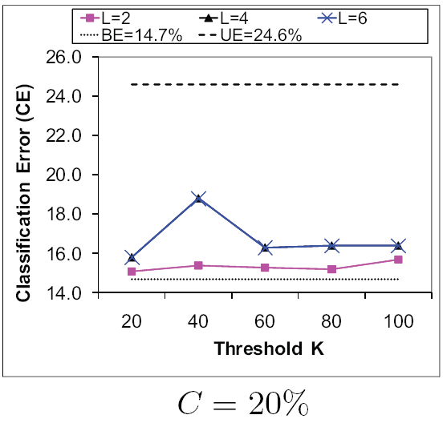
Data Utility
Adult dataset

Slide 32
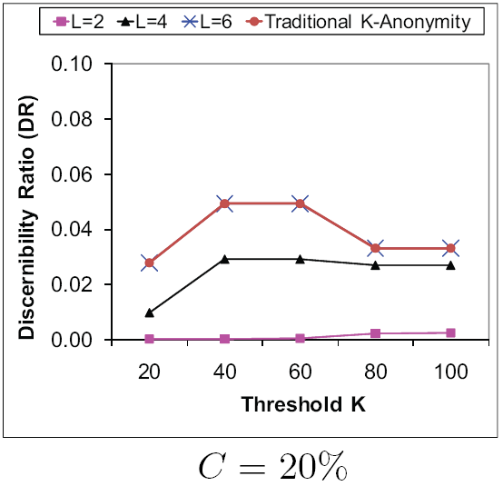
Data Utility
Adult dataset

Slide 33
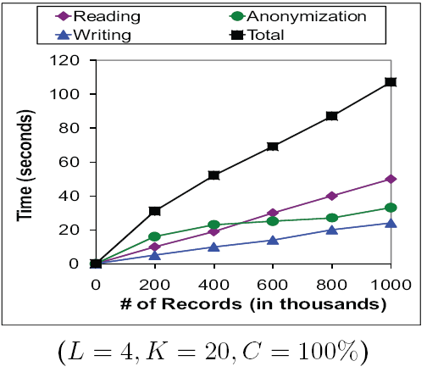
Efficiency and Scalability
Took at most 30 seconds for all previous experiments

Slide 34
Outline
Motivation & background
Privacy threats & information needs
Challenges
LKC-privacy model
Experimental results
Related work
Conclusions

Slide 35
Related work
Y. Xu, K. Wang, A. W. C. Fu, and P. S. Yu. Anonymizing transaction databases for publication. In SIGKDD, 2008.
Y. Xu, B. C. M. Fung, K. Wang, A. W. C. Fu, and J. Pei. Publishing sensitive transactions for itemset utility. In ICDM, 2008.
M. Terrovitis, N. Mamoulis, and P. Kalnis. Privacy-preserving anonymization of set-valued data. In VLDB, 2008.
G. Ghinita, Y. Tao, and P. Kalnis. On the anonymization of sparse high-dimensional data. In ICDE, 2008.

Slide 36
Outline
Motivation & background
Privacy threats & information needs
Challenges
LKC-privacy model
Experimental results
Related work
Conclusions

Slide 37
Conclusions
Successful demonstration of a real life application
It is important to educate health institute managements and medical practitioners
Health data are complex: combination of relational, transaction and textual data
Source codes and datasets download: http://www.ciise.concordia.ca/~fung/pub/RedCrossKDD09/

Slide 38
Thank You Very Much
Q&A

