Slide 1

Privacy-Preserving Data Mashup
Noman Mohammed
Concordia University
Montreal, QC, Canada
no_moham@ciise.concordia.ca
Benjamin C.M. Fung
Concordia University
Montreal, QC, Canada
fung@ciise.concordia.ca
Ke Wang
Simon Fraser University
Burnaby, BC, Canada
wangk@cs.sfu.ca
Patrick C. K. Hung
UOI T
Oshawa, ON, Canada
patrick.hung@uoit.ca
EDBT 2009

Slide 2
Outline
Problem: Private Data Mashup
Our solution: Top-Down Specialization for multiple Parties
Experimental results
Related works
Conclusions

Slide 3
Motivation
Mashup is a web technology that combines information and services from more than one source into a single web application.
Data mashup is a special type of mashup application that aims at integrating data from multiple data providers depending on the user's service request.
This research problem was discovered in a collaborative project with a financial institute in Sweden.

Slide 4
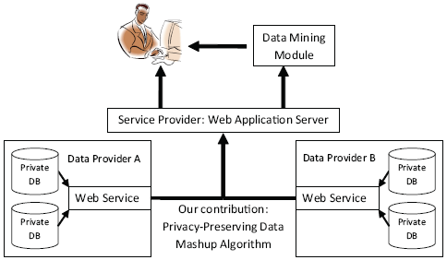
Architecture of Data Mashup
The data mashup application dynamically determines the data providers, collects information from them and then integrates the collected information to fulfill the service request.

Slide 5
Scenario
Suppose a loan company A and a bank B observe different sets of attributes about the same set of individuals identified by the common key SSN, e.g.,
T_{A}(SSN; Age; Sex; Balance)
T_{B}(SSN; Job; Salary)
These companies want to integrate their data to support better decision making such as loan or card limit approval. The integrated data can be shared with third party company C (credit card company).

Slide 6
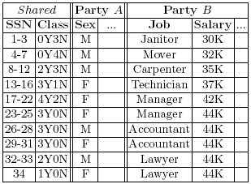
Scenario
After integrating the two tables (by matching the SSN field), the “female lawyer” becomes unique, therefore, vulnerable to be linked to sensitive information such as Salary.

Slide 7
Problem: Private Data Mashup
Given two private tables for the same set of records on different sets of attributes, we want to produce an integrated table on all attributes for release to both parties. The integrated table must satisfy the following two requirements:
  Classification requirement: The integrated data is as useful as possible to classification analysis.
  Privacy requirements:
    Given a specified subset of attributes called a quasi-identifier (QID), each value of the quasi-identifier must identify at least k records [5].
    At any time in this integration / generalization, no party should learn more detailed information about the other party other than those in the final integrated table.
Notes:
The larger the k, the more difficult it is to identify an individual using the quasi-identifier. This requirement can be satisfied by generalizing domain values into higher level concepts.

Slide 8
Example: k-anonymity
QID₁ = {Sex, Job}, k₁ = 4
Sex | Job | Salary | Class | # of Recs.
M | Janitor | 30K | 0Y3N | 3
M | Mover | 32K | 0Y4N | 4
M | Carpenter | 35K | 2Y3N | 5
F | Technician | 37K | 3Y1N | 4
F | Manager | 42K | 4Y2N | 6
F | Manager | 44K | 3Y0N | 3
M | Accountant | 44K | 3Y0N | 3
F | Accountant | 44K | 3Y0N | 3
M | Lawyer | 44K | 2Y0N | 2
F | Lawyer | 44K | 1Y0N | 1
 |  |  | Total: | 34
a( qid₁ )
3
4
5
4
9
3
3
2
1
Minimum a(qid₁) = 1

Slide 9
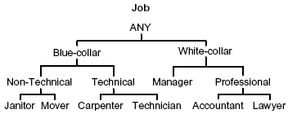
Generalization
Sex | Job | … | Class | a(qid₁)
M | Janitor |  | 0Y3N | 3
M | Mover |  | 0Y4N | 4
M | Carpenter |  | 2Y3N | 5
F | Technician |  | 3Y1N | 4
F | Manager |  | 4Y2N | 9
F | Manager |  | 3Y0N
M | Accountant |  | 3Y0N | 3
F | Accountant |  | 3Y0N | 3
M | Lawyer |  | 2Y0N | 2
F | Lawyer |  | 1Y0N | 1
Sex | Job | … | Class | a(qid₁)
M | Janitor |  | 0Y3N | 3
M | Mover |  | 0Y4N | 4
M | Carpenter |  | 2Y3N | 5
F | Technician |  | 3Y1N | 4
F | Manager |  | 4Y2N | 9
F | Manager |  | 3Y0N
M | Professional |  | 5Y0N | 5
F | Professional |  | 4Y0N | 4

Slide 10
Intuition
Classification goal and privacy goal have no conflicts:
  Privacy goal: mask sensitive information, usually specific descriptions that identify individuals.
  Classification goal: extract general structures that capture trends and patterns.
A table contains multiple classification structures. Generalizations destroy some classification structures, but other structures emerge to help.
If generalization is “carefully” performed, identifying information can be masked while still preserving trends and patterns for classification.

Slide 11
Two simple but incorrect approaches
Generalize-then-integrate: first generalize each table locally and then integrate the generalized tables.
  Does not work for QID that spans two tables.
Integrate-then-generalize: first integrate the two tables and then generalize the integrated table using some single table methods, such as:
  Iyengar’s Genetic Algorithm [10] or
  Fung et al.’s Top-Down Specialization [8].
  Any party holding the integrated table will immediately know all private information of both parties. Violated our privacy requirement.

Slide 12

Algorithm Top-Down Specialization (TDS) for Single Party
Initialize every value in T to the top most value.
Initialize Cut_{i} to include the top most value.
while there is some candidate in UCut_{i} do
Find the Winner specialization of the highest Score.
Perform the Winner specialization on T.
Update Cut_{i} and Score(x) in UCut_{i}.
end while
return Generalized T and UCut_{i}.
Salary
ANY
[1-99)
[1-37)
[37-99)

Slide 13
Algorithm Privacy-preserving Data Mashup for 2 Parties (PPMashup)
Initialize every value in T_{A} to the top most value.
Initialize Cut_{i} to include the top most value.
while there is some candidate in UCut_{i} do
Find the local candidate x of the highest Score(x).
Communicate Score(x) with Party B to find the winner.
if the winner w is local then
Specialize w on T_{A.}
Instruct Party B to specialize w.
else
Wait for the instruction from Party B.
Specialize w on T_{A} using the instruction.
end if
Update the local copy of Cut_{i}.
Update Score(x) in UCut_{i}.
end while
return Generalized T_{A} and UCut_{i}.

Slide 14

Search Criteria: Score
Consider a specialization v → child(v). To heuristically maximize the information of the generalized data for achieving a given anonymity, we favor the specialization on v that has the maximum information gain for each unit of anonymity loss:

Slide 15
Search Criteria: Score
R_{v} denotes the set of records having value v before the specialization. R_{c} denotes the set of records having value c after the specialization where c ∈ child(v).
I(R_{x}) is the entropy of R_{x}:
freq(R_{x}, cls) is the number records in R_{x} having the class cls.
Intuitively, I(R_{x}) measures the impurity of classes for the data records in R_{x} . A good specialization reduces the impurity of classes.
Notes:
A good specialization reduces the impurity of classes, i.e., having a large InfoGain(v)

Slide 16
Perform the Winner Specialization
To perform the Winner specialization w → child(w), we need to retrieve R_{w}, the set of data records containing the value Winner.
Taxonomy Indexed PartitionS (TIPS) is a tree structure with each node representing a generalized record over UQID_{j}, and each child node representing a specialization of the parent node on exactly one attribute.
Stored with each leaf node is the set of data records having the same generalized record.
Notes:
At any time, the generalized data is represented by the leaf partitions of TIPS.

Slide 17
Consider QID₁ = {Sex, Job}, QID₂ = {Job, Salary}
A
B
B
Sex | Job | Salary | # of Recs.
ANY_Sex | ANY_Job | [1-99) | 34
IDs: 1-12
IDs: 13-34
ANY_Sex | ANY_Job | [1-37) | 12
ANY_Sex | ANY_Job | [37-99) | 22
ANY_Sex | Blue-collar | [1-37) | 12
ANY_Sex | Blue-collar | [37-99) | 4
ANY_Sex | White-collar | [37-99) | 18
Link_{ANY_Sex}
Link_{[37-99)}
Salary
ANY
[1-99)
[1-37)
[37-99)

Slide 18
Practical Features of PPMashup
Handling multiple QIDs
  Treating all QIDs as a single QID leads to over generalization.
  QIDs span across two parties.
Handling both categorical and continuous attributes
  Dynamically generate taxonomy tree for continuous attributes.
Anytime solution
  Determine a desired trade-off between privacy and accuracy.
  Stop any time and obtain a generalized table satisfying the anonymity requirement. Bottom-up approach does not support this feature.
Scalable computation

Slide 19
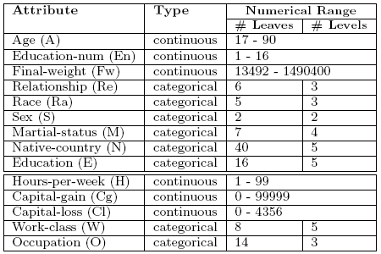
Experimental Evaluation
Data quality & Efficiency
  A broad range of anonymity requirements.
  Used C4.5 classifier.
Adult data set
  Used in Iyengar [6].
  Census data.
  6 continuous attributes.
  8 categorical attributes.
  Two classes.
  30162 recs. for training.
  15060 recs. for testing.

Slide 20
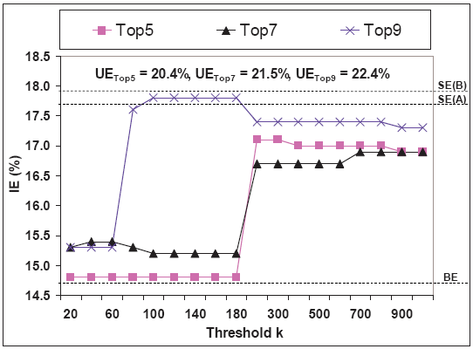
Data Quality
Include the TopN most important attributes into a SingleQID, which is more restrictive than breaking them into multiple QIDs.

Slide 21
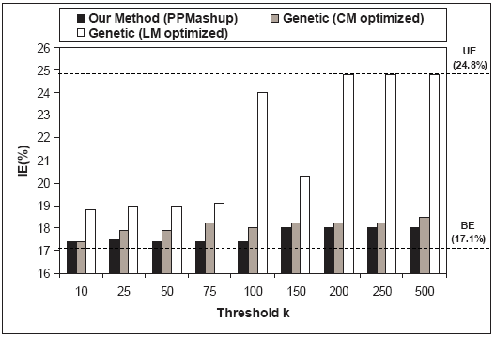
Comparing with Genetic Algorithm
Our method is comparable with genetic algorithm in terms of data quality

Slide 22
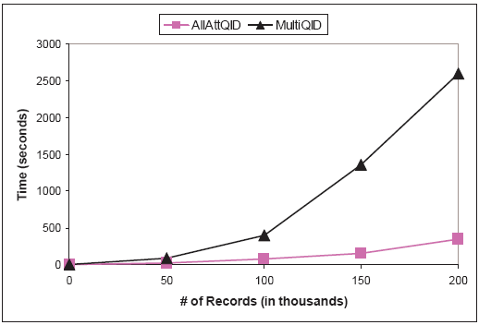
Efficiency and Scalability
Took at most 20 seconds for all previous experiments.
Replicate the Adult data set and substitute some random data.

Slide 23
Related Works
Sweeney: achieve k-anonymity by generalization [6, 7].
Fung et. al. [8], Wang et. al. [9], Iyengar [10], LeFevre et. at. [12]: consider anonymity for classification on a single data source.
Jiang and Clifton[13]: Integrate two private databases together but not aiming preserving classification analysis.

Slide 24
Conclusions
We studied private data mashup of multiple databases for the purpose of a joint classification analysis.
We formalized this problem as achieving the k-anonymity on the integrated data without revealing more detailed information in this process.
Quality classification and privacy preservation can coexist.
Allow data sharing instead of only result sharing.
Great applicability to both public and private sectors that share information for mutual benefits.

Slide 25
References
The House of Commons in Canada: The personal information protection and electronic documents act (2000) http://www.privcom.gc.ca/
Agrawal, R., Evfimievski, A., Srikant, R.: Information sharing across private databases. In: Proceedings of the 2003 ACM SIGMOD International Conference on Management of Data, San Diego, California (2003)
Yao, A.C.: Protocols for secure computations. In: Proceedings of the 23rd Annual IEEE Symposium on Foundations of Computer Science. (1982)
Liang, G., Chawathe, S.S.: Privacy-preserving inter-database operations. In: Proceedings of the 2nd Symposium on Intelligence and Security Informatics. (2004)
Dalenius, T.: Finding a needle in a haystack - or identifying anonymous census record. Journal of Official Statistics 2 (1986) 329-336
Sweeney, L.: Achieving k-anonymity privacy protection using generalization and suppression. International Journal on Uncertainty, Fuzziness, and Knowledge-based Systems 10 (2002) 571-588
Hundepool, A., Willenborg, L.: μ- and τ-argus: Software for statistical disclosure control. In: Third International Seminar on Statistical Confidentiality, Bled (1996)
Fung, B.C.M., Wang, K., Yu, P.S.: Top-down specialization for information and privacy preservation. In: Proceedings of the 21st IEEE International Conference on Data Engineering, Tokyo, Japan (2005) 205-216

Slide 26
References
Wang, K., Yu, P., Chakraborty, S.: Bottom-up generalization: a data mining solution to privacy protection. In: Proceedings of the 4th IEEE International Conference on Data Mining. (2004)
Iyengar, V.S.: Transforming data to satisfy privacy constraints. In: Proceedings of the 8th ACM SIGKDD International Conference on Knowledge Discovery and Data Mining, Edmonton, AB, Canada (2002) 279-288
Quinlan, J.R.: C4.5: Programs for Machine Learning. Morgan Kaufmann (1993)
LeFevre, K. , DeWitt, D. J., Ramakrishnan, R.: Workload-aware anonymization. In: Proceedings of the 12th ACM SIGKDD, Philadelphia, PA, (2006)
Jiang, W., Clifton, C.: A secure distributed framework for achieving k-anonymity. In: Very Large Data Bases Journal (VLDBJ), 15(4):316-333, November (2006)

Slide 27
Thank you !

