Slide 1
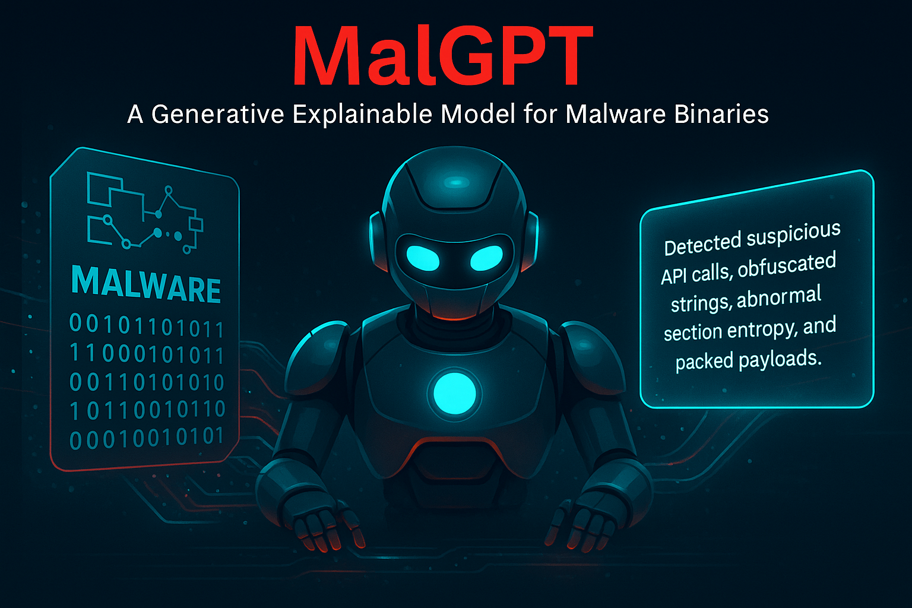
MalGPT
A Generative Explainable Model for Malware Binaries
Mohd Saqib
McGill University
Benjamin C. M. Fung
McGill University
Steven. H. H. Ding
McGill University
Philippe Charland
Defence R&D Canada
ECML PKDD 2025
Notes:
July 2024. It was just another normal day for thousands of people trading on India’s largest crypto exchange, WazirX.
Investors logged in, checked their balances, and carried on — unaware of what was about to happen.
In less than an hour, everything changed. $235 million vanished — almost half of the exchange’s reserves — gone in a blink.
What’s shocking is not just the scale of the theft, but how it happened. WazirX had strong defenses: multi-signature wallets, hardware protection, whitelists. The alarms went off, but no one could explain what the malware was really doing until it was too late.
And that’s the real problem in cybersecurity today. Detection without explanation is like sounding an alarm without telling us where the fire is. That gap — between knowing and understanding — is exactly what motivated my work. Today, I’ll present MalGPT, a model that takes unreadable binaries and turns them into human-readable explanations.

Slide 2
MalGPT
Objective
Introduction
Background
Proposed Model
Results and Discussion
Conclusion

Slide 3

Introduction
Malware detection with DL models → high accuracy but black-box
Traditional XAI (LIME, SHAP) works for text/images → fails for binaries
Analysts + decision makers need human-readable explanations
Real motivation: Traditional models show detection ≠ understanding
Goal → Build a framework that detects + explains malware binaries

Slide 4
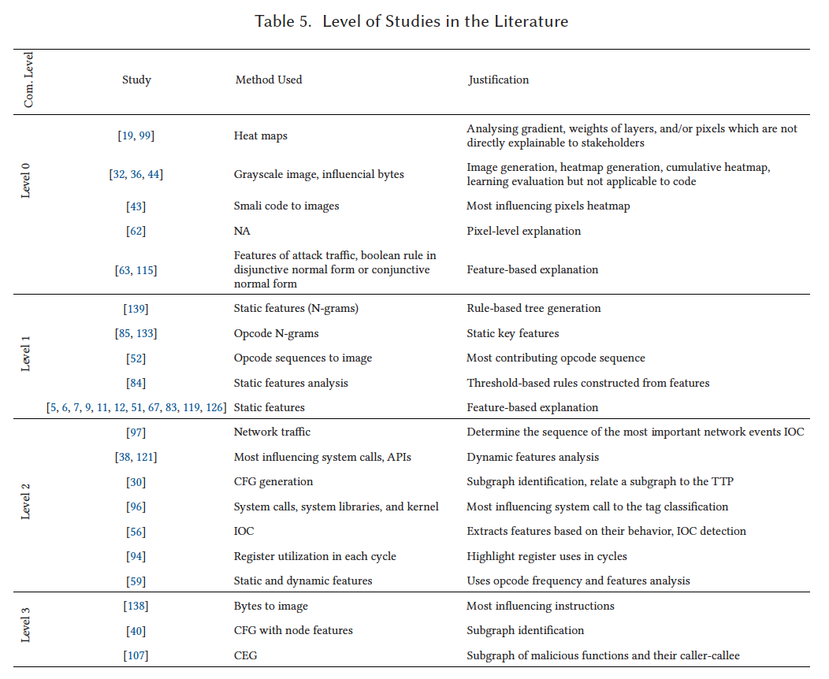
MalGPT
Literature
Levels of Communication in XAI for Malware Analysis
M. Saqib, S. Mahdavifar, B. C. M. Fung, and P. Charland. A comprehensive analysis of explainable AI for malware hunting. ACM Computing Surveys (CSUR), 56(12.314):1-40, October 2024.

Slide 5
MalGPT
Literature
Levels of Communication in XAI for Malware Analysis
Level 0 – Visualization & Patterns (Lowest Abstraction)
Examples: heatmaps, trees, rule visualizations.
Not directly meaningful to security experts but show overall model behavior.
Useful for data analysts / entry-level security staff to spot anomalies or patterns.
M. Saqib, S. Mahdavifar, B. C. M. Fung, and P. Charland. A comprehensive analysis of explainable AI for malware hunting. ACM Computing Surveys (CSUR), 56(12.314):1-40, October 2024.

Slide 6
MalGPT
Literature
Levels of Communication in XAI for Malware Analysis
Level 0 – Visualization & Patterns (Lowest Abstraction)
Level 1 – Static Features (Basic Indicators)
Based on static properties: LIME/SHAP, entropy, PE headers.
Tells if a file looks suspicious.
Helps in initial threat assessment and tool configuration.
Stakeholders: security admins, malware analysts (early incident response).
M. Saqib, S. Mahdavifar, B. C. M. Fung, and P. Charland. A comprehensive analysis of explainable AI for malware hunting. ACM Computing Surveys (CSUR), 56(12.314):1-40, October 2024.

Slide 7
MalGPT
Literature
Levels of Communication in XAI for Malware Analysis
Level 0 – Visualization & Patterns (Lowest Abstraction)
Level 1 – Static Features (Basic Indicators)
Level 2 – Dynamic Features (Behavioral Clues)
Based on runtime behavior: API calls, system activity, network traffic.
Offers deeper insight into what the malware is doing.
Supports threat hunting and incident response.
Stakeholders: network admins, incident responders.
M. Saqib, S. Mahdavifar, B. C. M. Fung, and P. Charland. A comprehensive analysis of explainable AI for malware hunting. ACM Computing Surveys (CSUR), 56(12.314):1-40, October 2024.

Slide 8
MalGPT
Literature
Levels of Communication in XAI for Malware Analysis
Level 0 – Visualization & Patterns (Lowest Abstraction)
Level 1 – Static Features (Basic Indicators)
Level 2 – Dynamic Features (Behavioral Clues)
Level 3 – Reverse Engineering (Highest Abstraction & Fidelity)
Focus on code-level features: subgraphs, assembly analysis.
Provides deep understanding of malware’s operations and strategies.
Critical for forensic analysts and advanced security researchers.
Enables drawing final conclusions about risks and attack mechanisms.
M. Saqib, S. Mahdavifar, B. C. M. Fung, and P. Charland. A comprehensive analysis of explainable AI for malware hunting. ACM Computing Surveys (CSUR), 56(12.314):1-40, October 2024.

Slide 9
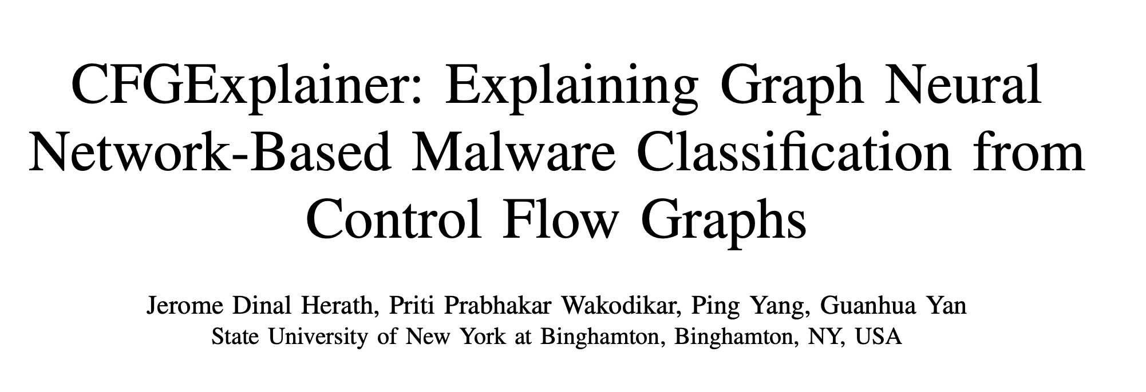
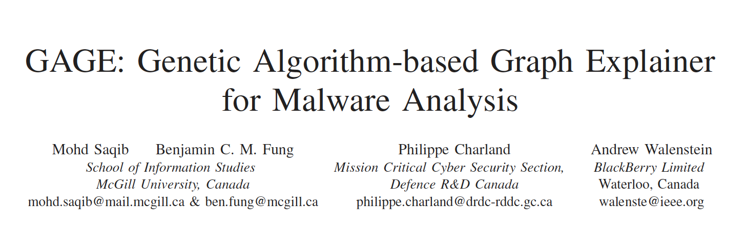
MalGPT
Literature
Levels of Communication in XAI for Malware Analysis
Level 0 – Visualization & Patterns (Lowest Abstraction)
Level 1 – Static Features (Basic Indicators)
Level 2 – Dynamic Features (Behavioral Clues)
Level 3 – Reverse Engineering (Highest Abstraction & Fidelity)
Level X – Natural Language based Explainability
M. Saqib, S. Mahdavifar, B. C. M. Fung, and P. Charland. A comprehensive analysis of explainable AI for malware hunting. ACM Computing Surveys (CSUR), 56(12.314):1-40, October 2024.

Slide 10
MalGPT
Literature
Low-Level Explainability
LIME, SHAP → highlight feature importance (e.g., opcode, static features)
Limited → too technical, not human-friendly
High-Level Explainability
CFGExplainer, GAGE → explain malware via graphs
Still technical, not readable by non-experts
Gap → No dataset pairing binaries with natural language explanations
MalGPT → Leverage LLMs (Transformers, GPT-style) for explainability
Notes:
July 2024. It was just another normal day for thousands of people trading on India’s largest crypto exchange, WazirX.
Investors logged in, checked their balances, and carried on — unaware of what was about to happen.
In less than an hour, everything changed. $235 million vanished — almost half of the exchange’s reserves — gone in a blink.
What’s shocking is not just the scale of the theft, but how it happened. WazirX had strong defenses: multi-signature wallets, hardware protection, whitelists. The alarms went off, but no one could explain what the malware was really doing until it was too late.
And that’s the real problem in cybersecurity today. Detection without explanation is like sounding an alarm without telling us where the fire is. That gap — between knowing and understanding — is exactly what motivated my work. Today, I’ll present MalGPT, a model that takes unreadable binaries and turns them into human-readable explanations.

Slide 11
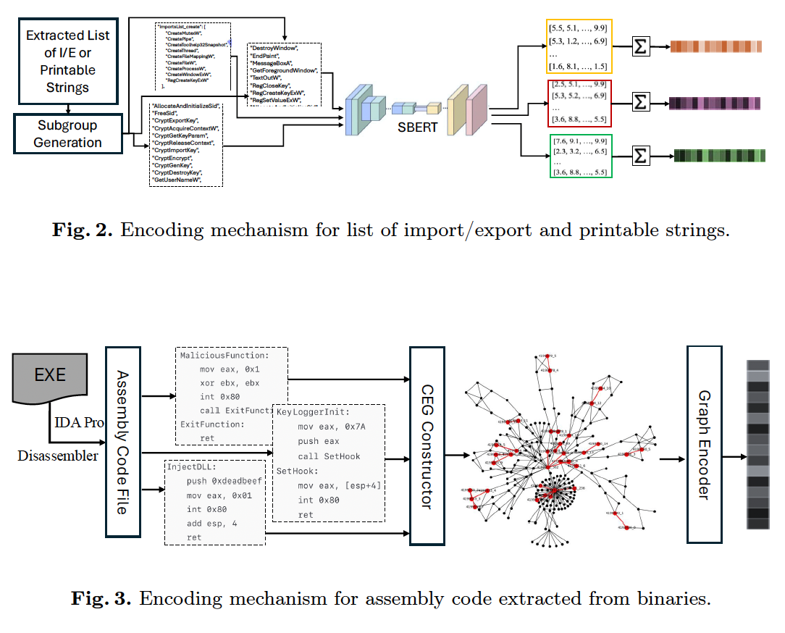
MalGPT
Proposed Model (MalGPT)
Feature Extraction
PE Header Features (entropy, DLLs, size)
Import/Export Functions (create, delete, API calls)
Printable Strings (URLs, IPs, keywords)
Canonical Executable Graphs (CEGs) from assembly
Notes:
July 2024. It was just another normal day for thousands of people trading on India’s largest crypto exchange, WazirX.
Investors logged in, checked their balances, and carried on — unaware of what was about to happen.
In less than an hour, everything changed. $235 million vanished — almost half of the exchange’s reserves — gone in a blink.
What’s shocking is not just the scale of the theft, but how it happened. WazirX had strong defenses: multi-signature wallets, hardware protection, whitelists. The alarms went off, but no one could explain what the malware was really doing until it was too late.
And that’s the real problem in cybersecurity today. Detection without explanation is like sounding an alarm without telling us where the fire is. That gap — between knowing and understanding — is exactly what motivated my work. Today, I’ll present MalGPT, a model that takes unreadable binaries and turns them into human-readable explanations.

Slide 12
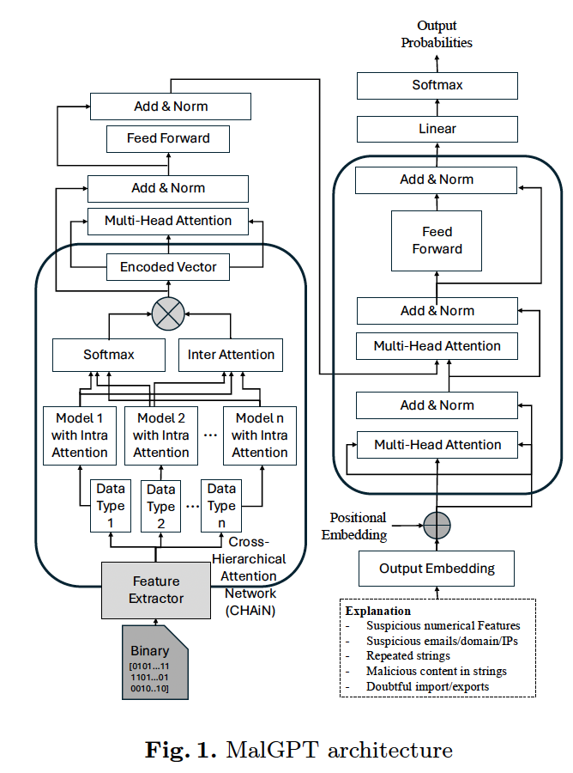
MalGPT
Proposed Model (MalGPT)
Feature Extraction
CHAiN (Cross-Hierarchical Attention Network)
Captures intra-modality + inter-modality relationships
Notes:
July 2024. It was just another normal day for thousands of people trading on India’s largest crypto exchange, WazirX.
Investors logged in, checked their balances, and carried on — unaware of what was about to happen.
In less than an hour, everything changed. $235 million vanished — almost half of the exchange’s reserves — gone in a blink.
What’s shocking is not just the scale of the theft, but how it happened. WazirX had strong defenses: multi-signature wallets, hardware protection, whitelists. The alarms went off, but no one could explain what the malware was really doing until it was too late.
And that’s the real problem in cybersecurity today. Detection without explanation is like sounding an alarm without telling us where the fire is. That gap — between knowing and understanding — is exactly what motivated my work. Today, I’ll present MalGPT, a model that takes unreadable binaries and turns them into human-readable explanations.

Slide 13
MalGPT
Proposed Model (MalGPT)
Feature Extraction
CHAiN (Cross-Hierarchical Attention Network)
Captures intra-modality + inter-modality relationships
Notes:
July 2024. It was just another normal day for thousands of people trading on India’s largest crypto exchange, WazirX.
Investors logged in, checked their balances, and carried on — unaware of what was about to happen.
In less than an hour, everything changed. $235 million vanished — almost half of the exchange’s reserves — gone in a blink.
What’s shocking is not just the scale of the theft, but how it happened. WazirX had strong defenses: multi-signature wallets, hardware protection, whitelists. The alarms went off, but no one could explain what the malware was really doing until it was too late.
And that’s the real problem in cybersecurity today. Detection without explanation is like sounding an alarm without telling us where the fire is. That gap — between knowing and understanding — is exactly what motivated my work. Today, I’ll present MalGPT, a model that takes unreadable binaries and turns them into human-readable explanations.

Slide 14
MalGPT
Proposed Model (MalGPT)
Feature Extraction
CHAiN (Cross-Hierarchical Attention Network)
GPT Decoder
Generates human-readable explanations from fused embeddings
Output = Malware classification + natural language explanation
Notes:
July 2024. It was just another normal day for thousands of people trading on India’s largest crypto exchange, WazirX.
Investors logged in, checked their balances, and carried on — unaware of what was about to happen.
In less than an hour, everything changed. $235 million vanished — almost half of the exchange’s reserves — gone in a blink.
What’s shocking is not just the scale of the theft, but how it happened. WazirX had strong defenses: multi-signature wallets, hardware protection, whitelists. The alarms went off, but no one could explain what the malware was really doing until it was too late.
And that’s the real problem in cybersecurity today. Detection without explanation is like sounding an alarm without telling us where the fire is. That gap — between knowing and understanding — is exactly what motivated my work. Today, I’ll present MalGPT, a model that takes unreadable binaries and turns them into human-readable explanations.

Slide 15
MalGPT
Proposed Model (MalGPT)
Feature Extraction
CHAiN (Cross-Hierarchical Attention Network)
GPT Decoder
Notes:
July 2024. It was just another normal day for thousands of people trading on India’s largest crypto exchange, WazirX.
Investors logged in, checked their balances, and carried on — unaware of what was about to happen.
In less than an hour, everything changed. $235 million vanished — almost half of the exchange’s reserves — gone in a blink.
What’s shocking is not just the scale of the theft, but how it happened. WazirX had strong defenses: multi-signature wallets, hardware protection, whitelists. The alarms went off, but no one could explain what the malware was really doing until it was too late.
And that’s the real problem in cybersecurity today. Detection without explanation is like sounding an alarm without telling us where the fire is. That gap — between knowing and understanding — is exactly what motivated my work. Today, I’ll present MalGPT, a model that takes unreadable binaries and turns them into human-readable explanations.

Slide 16
Results and Discussion
MalGPT
Dataset
23.3 GB binaries, 1702 files
4 malware families: DownloadAdmin, Firseria, Emotet, Gamarue + Benign
Ground-truth explanations generated via VirusTotal + analyst review
Notes:
July 2024. It was just another normal day for thousands of people trading on India’s largest crypto exchange, WazirX.
Investors logged in, checked their balances, and carried on — unaware of what was about to happen.
In less than an hour, everything changed. $235 million vanished — almost half of the exchange’s reserves — gone in a blink.
What’s shocking is not just the scale of the theft, but how it happened. WazirX had strong defenses: multi-signature wallets, hardware protection, whitelists. The alarms went off, but no one could explain what the malware was really doing until it was too late.
And that’s the real problem in cybersecurity today. Detection without explanation is like sounding an alarm without telling us where the fire is. That gap — between knowing and understanding — is exactly what motivated my work. Today, I’ll present MalGPT, a model that takes unreadable binaries and turns them into human-readable explanations.

Slide 17
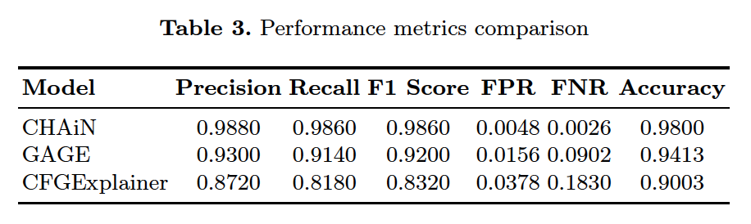
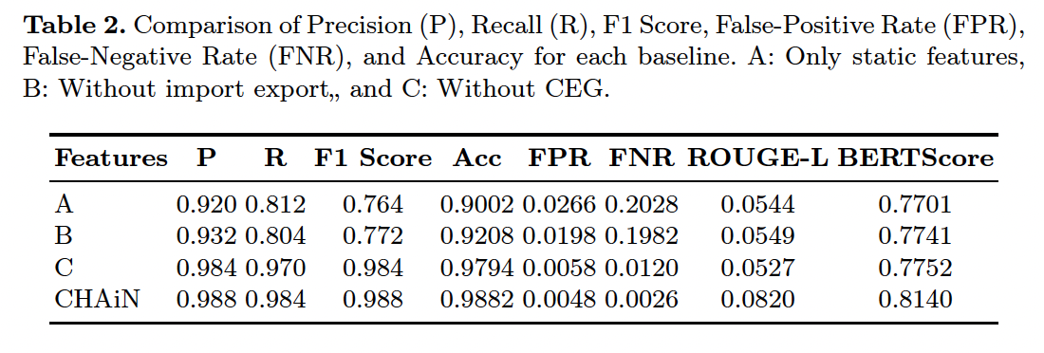
Results and Discussion
MalGPT
Performance
Accuracy: 98.8% (better than GAGE 94.1%, CFGExplainer 90%)
ROUGE-L & BERTScore → Higher semantic alignment with real explanations
Notes:
July 2024. It was just another normal day for thousands of people trading on India’s largest crypto exchange, WazirX.
Investors logged in, checked their balances, and carried on — unaware of what was about to happen.
In less than an hour, everything changed. $235 million vanished — almost half of the exchange’s reserves — gone in a blink.
What’s shocking is not just the scale of the theft, but how it happened. WazirX had strong defenses: multi-signature wallets, hardware protection, whitelists. The alarms went off, but no one could explain what the malware was really doing until it was too late.
And that’s the real problem in cybersecurity today. Detection without explanation is like sounding an alarm without telling us where the fire is. That gap — between knowing and understanding — is exactly what motivated my work. Today, I’ll present MalGPT, a model that takes unreadable binaries and turns them into human-readable explanations.

Slide 18
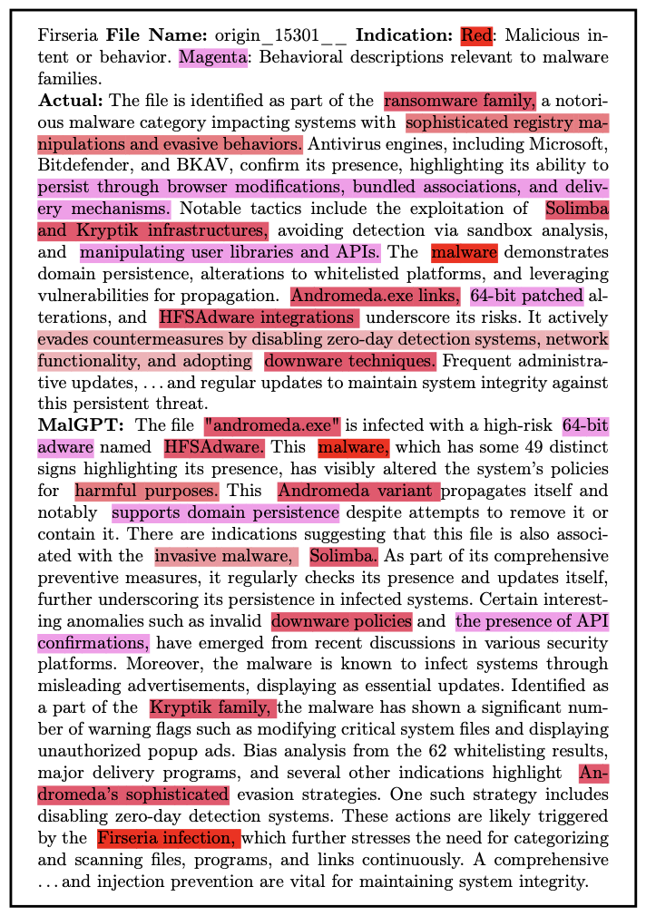
Results and Discussion
Case Study
Firseria ransomware → MalGPT correctly described persistence, registry edits, evasion
Notes:
The evaluation of MalGPT focused not just on language fluency, but domain correctness — whether the generated explanation accurately reflects the malware's behavior.
In expert validation studies, MalGPT explanations were rated 78.5% correct in identifying malicious behavior and rationale — significantly higher than outputs from generic GPT-2, BART, or T5 models fine-tuned on security data.
In real-world testing, security analysts reported 40% faster response times when provided with MalGPT-generated narratives compared to traditional feature tables.
Importantly, MalGPT maintained robustness when faced with adversarial samples or unseen malware families, thanks to the CHAiN module’s integration of multi-modal inputs.
This positions MalGPT as the first explainable system capable of producing complete, actionable, natural language explanations in cybersecurity.

Slide 19
Results and Discussion
Case Study
Firseria ransomware → MalGPT correctly described persistence, registry edits, evasion
Notes:
The evaluation of MalGPT focused not just on language fluency, but domain correctness — whether the generated explanation accurately reflects the malware's behavior.
In expert validation studies, MalGPT explanations were rated 78.5% correct in identifying malicious behavior and rationale — significantly higher than outputs from generic GPT-2, BART, or T5 models fine-tuned on security data.
In real-world testing, security analysts reported 40% faster response times when provided with MalGPT-generated narratives compared to traditional feature tables.
Importantly, MalGPT maintained robustness when faced with adversarial samples or unseen malware families, thanks to the CHAiN module’s integration of multi-modal inputs.
This positions MalGPT as the first explainable system capable of producing complete, actionable, natural language explanations in cybersecurity.

Slide 20
Results and Discussion
Case Study
Firseria ransomware → MalGPT correctly described persistence, registry edits, evasion
Notes:
The evaluation of MalGPT focused not just on language fluency, but domain correctness — whether the generated explanation accurately reflects the malware's behavior.
In expert validation studies, MalGPT explanations were rated 78.5% correct in identifying malicious behavior and rationale — significantly higher than outputs from generic GPT-2, BART, or T5 models fine-tuned on security data.
In real-world testing, security analysts reported 40% faster response times when provided with MalGPT-generated narratives compared to traditional feature tables.
Importantly, MalGPT maintained robustness when faced with adversarial samples or unseen malware families, thanks to the CHAiN module’s integration of multi-modal inputs.
This positions MalGPT as the first explainable system capable of producing complete, actionable, natural language explanations in cybersecurity.

Slide 21
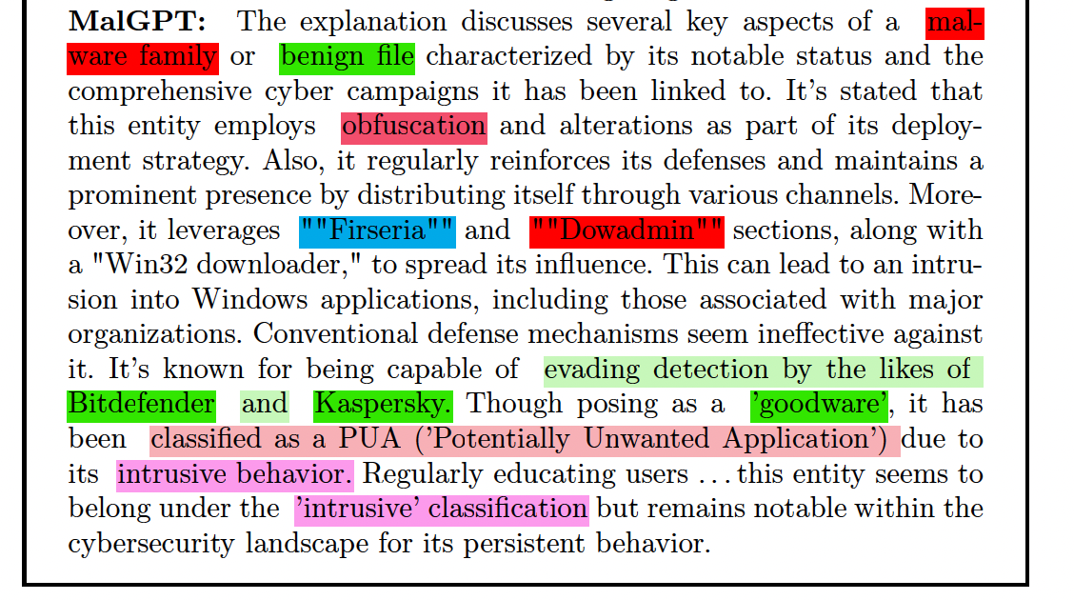
Results and Discussion
MalGPT
Limitations
Occasional hallucinations
Data dependency (VirusTotal reports, limited malware families)
Notes:
July 2024. It was just another normal day for thousands of people trading on India’s largest crypto exchange, WazirX.
Investors logged in, checked their balances, and carried on — unaware of what was about to happen.
In less than an hour, everything changed. $235 million vanished — almost half of the exchange’s reserves — gone in a blink.
What’s shocking is not just the scale of the theft, but how it happened. WazirX had strong defenses: multi-signature wallets, hardware protection, whitelists. The alarms went off, but no one could explain what the malware was really doing until it was too late.
And that’s the real problem in cybersecurity today. Detection without explanation is like sounding an alarm without telling us where the fire is. That gap — between knowing and understanding — is exactly what motivated my work. Today, I’ll present MalGPT, a model that takes unreadable binaries and turns them into human-readable explanations.

Slide 22
Results and Discussion
MalGPT
Limitations
Occasional hallucinations
Data dependency (VirusTotal reports, limited malware families)
Notes:
July 2024. It was just another normal day for thousands of people trading on India’s largest crypto exchange, WazirX.
Investors logged in, checked their balances, and carried on — unaware of what was about to happen.
In less than an hour, everything changed. $235 million vanished — almost half of the exchange’s reserves — gone in a blink.
What’s shocking is not just the scale of the theft, but how it happened. WazirX had strong defenses: multi-signature wallets, hardware protection, whitelists. The alarms went off, but no one could explain what the malware was really doing until it was too late.
And that’s the real problem in cybersecurity today. Detection without explanation is like sounding an alarm without telling us where the fire is. That gap — between knowing and understanding — is exactly what motivated my work. Today, I’ll present MalGPT, a model that takes unreadable binaries and turns them into human-readable explanations.

Slide 23
MalGPT
Conclusion
First framework to explain malware binaries in natural language
Combines multi-modal features + CHAiN + GPT
Outperforms existing explainers in detection + explanation quality
Contributions
MalGPT model
CHAiN architecture
First dataset with natural language explanations
Future Work
Larger, more diverse malware datasets
Scale to apps, IoT malware, network viruses
Reduce hallucinations in explanations
Notes:
July 2024. It was just another normal day for thousands of people trading on India’s largest crypto exchange, WazirX.
Investors logged in, checked their balances, and carried on — unaware of what was about to happen.
In less than an hour, everything changed. $235 million vanished — almost half of the exchange’s reserves — gone in a blink.
What’s shocking is not just the scale of the theft, but how it happened. WazirX had strong defenses: multi-signature wallets, hardware protection, whitelists. The alarms went off, but no one could explain what the malware was really doing until it was too late.
And that’s the real problem in cybersecurity today. Detection without explanation is like sounding an alarm without telling us where the fire is. That gap — between knowing and understanding — is exactly what motivated my work. Today, I’ll present MalGPT, a model that takes unreadable binaries and turns them into human-readable explanations.

Slide 24
MalGPT
Thank You!
Any Question?
Notes:
July 2024. It was just another normal day for thousands of people trading on India’s largest crypto exchange, WazirX.
Investors logged in, checked their balances, and carried on — unaware of what was about to happen.
In less than an hour, everything changed. $235 million vanished — almost half of the exchange’s reserves — gone in a blink.
What’s shocking is not just the scale of the theft, but how it happened. WazirX had strong defenses: multi-signature wallets, hardware protection, whitelists. The alarms went off, but no one could explain what the malware was really doing until it was too late.
And that’s the real problem in cybersecurity today. Detection without explanation is like sounding an alarm without telling us where the fire is. That gap — between knowing and understanding — is exactly what motivated my work. Today, I’ll present MalGPT, a model that takes unreadable binaries and turns them into human-readable explanations.

