Slide 1
AsmDocGen: Generating Functional Natural Language Descriptions for
Assembly Code
Jesia Quader Yuki, Mohammadhossein Amouei, Benjamin C. M. Fung, Philippe
Charland, and Andrew Walenstein
School of Information Studies, McGill University, Montreal, QC, Canada
Mission Critical Cyber Security Section, Defence R&D Canada, Quebec, QC, Canada
BlackBerry Limited, Waterloo, ON, Canada

Slide 2
Assembly code summarization
Assembly code summarization is the process of producing human-readable summaries that aid in understanding the purpose and functionality of the assembly language code.

Slide 3
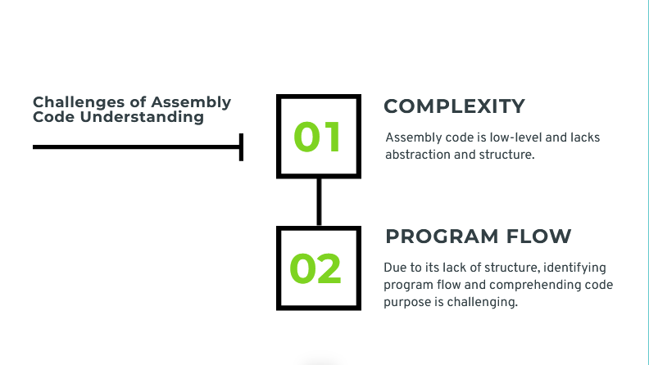

Slide 4
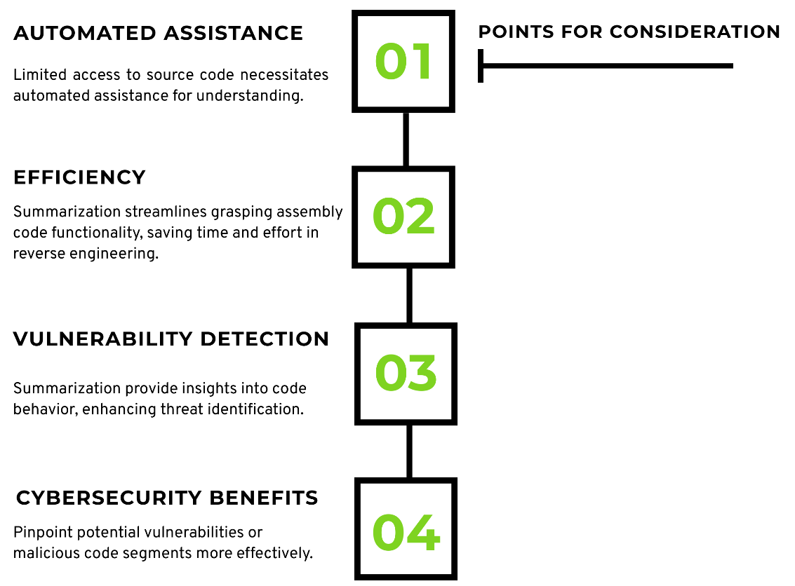

Slide 5
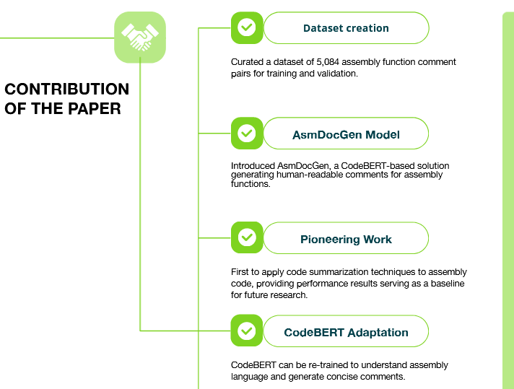

Slide 6
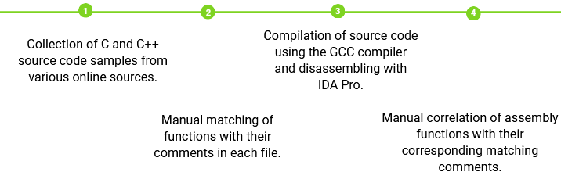
Dataset

Slide 7

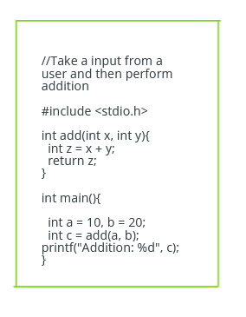
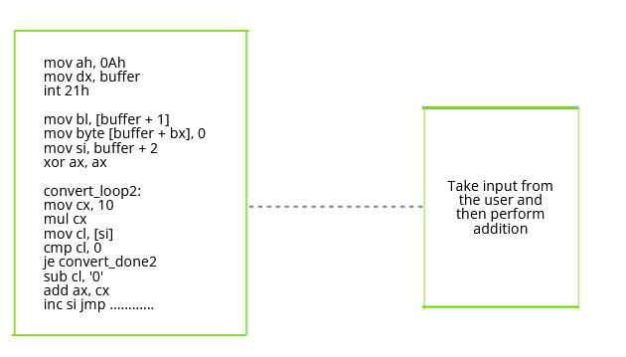
C code and its comments
ASM function with its corresponding comments
Before
After

Slide 8

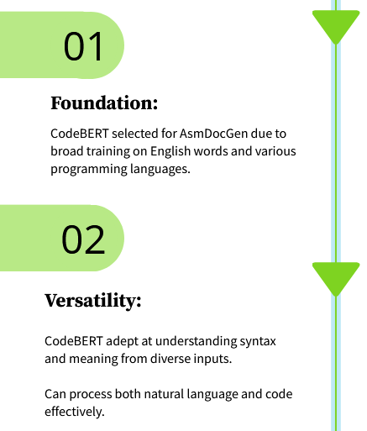
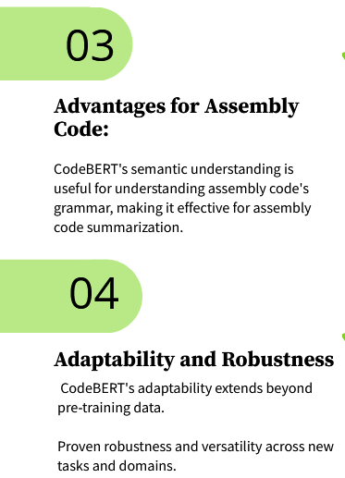

Slide 9
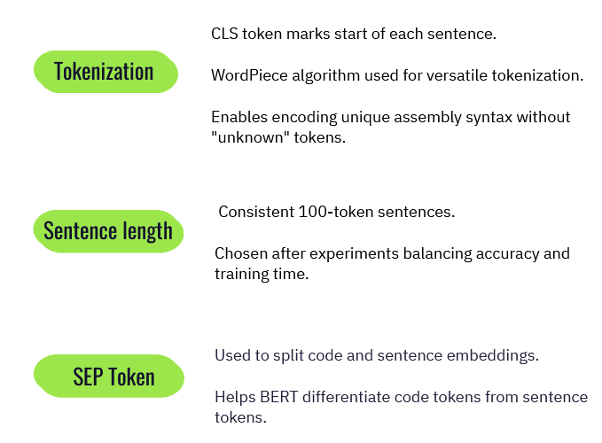
Data Preparation

Slide 10
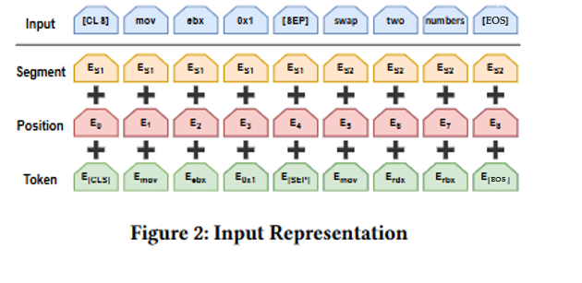
Model Visualization

Slide 11
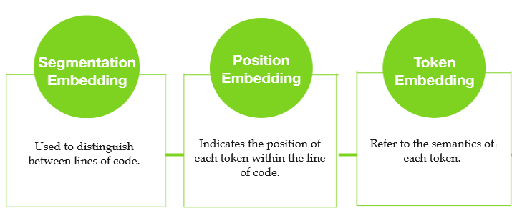
Types of Embedding

Slide 12
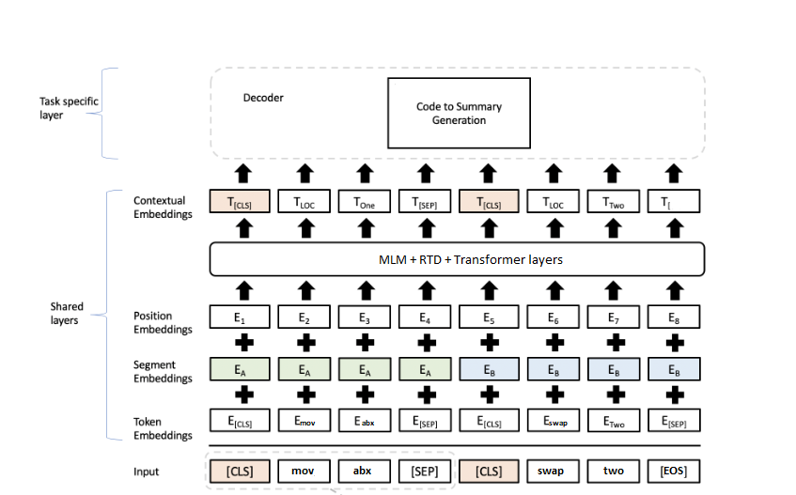
Model Visualization

Slide 13
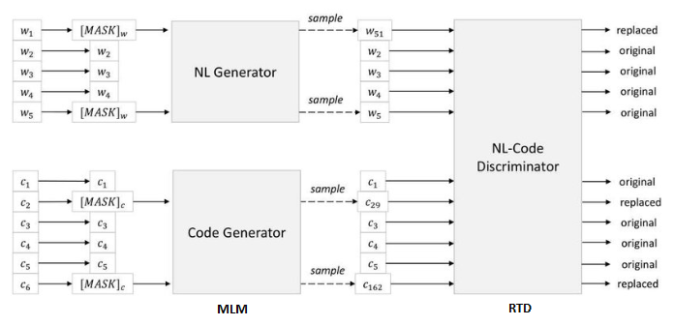
Model Visualization

Slide 14
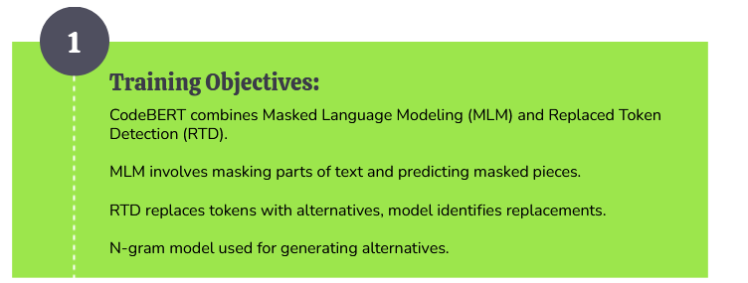
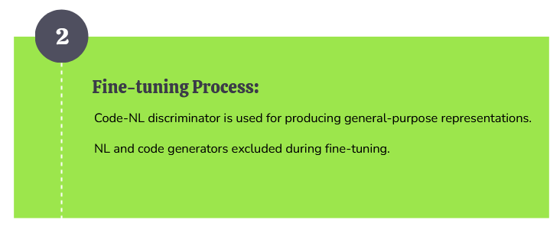
How does CodeBERT learn these representations?

Slide 15
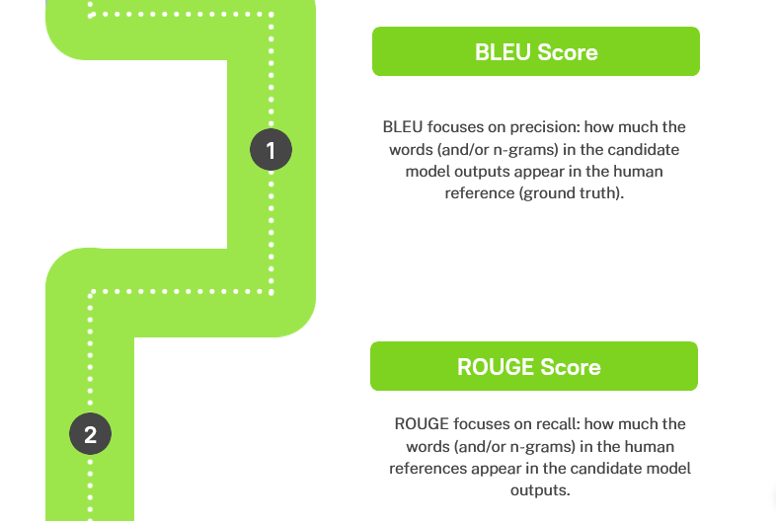
METRICS
ROUGE scores can also calculate precision, but unlike BLEU, they don't incorporate a brevity penalty. If a candidate translation is longer than its references, BLEU penalizes it, whereas ROUGE doesn't take this into account.

Slide 16
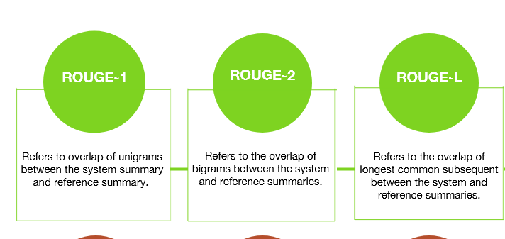
ROUGE-1, ROUGE-2, ROUGE-L

Slide 17
BLEU Score
Internal metrics such as BLEU scores, which compare the machine's translation to existing human-generated translations, are used to evaluate the automatic code comment generator.
BLEU Score | Interpretation
30 - 40 | Understandable to good translations
40 - 50 | High quality translations
50 - 60 | Very high quality, adequate, and fluent translations
> 60 | Quality often better than human

Slide 18
Results
MODEL | BLEU SCORE | Interpretation
Transformer | 34.54 | Understandable to good translations
Roberta | 50.01 | High quality translations
Distilbert | 50.82 | Very high quality, adequate, and fluent translations
BERT | 51.85 | Very high quality, adequate, and fluent translations
AsmDocGen | 54.10 | Very high quality, adequate, and fluent translations

Slide 19
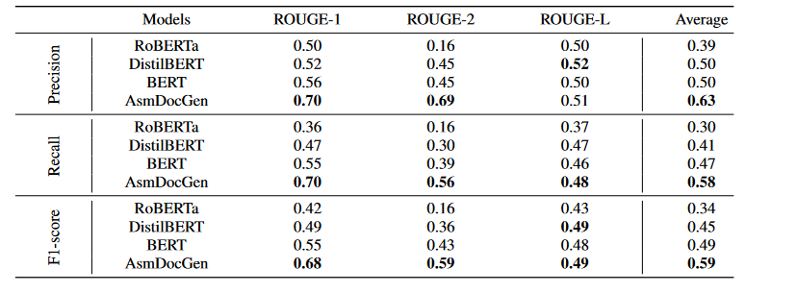
Results

Slide 20
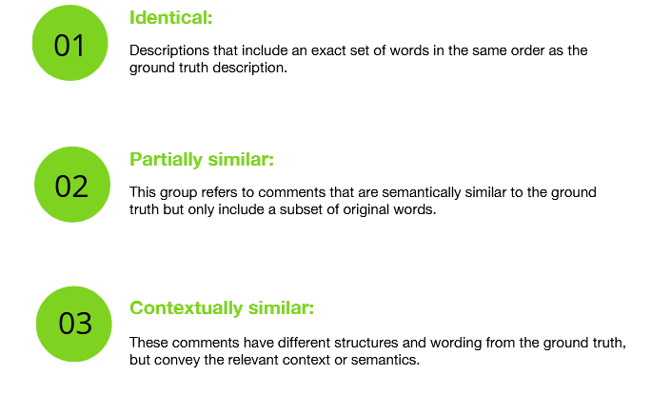
Qualitative analysis
Our observations found three types of correctly generated comments in terms of their similarity to the ground-truth comments. These three types are:

Slide 21
Results (Identical)
Ground truth: find vertex number and edges out
Generated Comment: find vertex number and edges out
Ground truth: perform subtraction then addition
Generated Comment: perform subtraction then addition
Ground truth: perform multiple multiplication
Generated Comment: perform multiple multiplication

Slide 22
Results (Partially similar)
Ground truth: find second thursday of september 2013
Generated Comment: find second thursday of sept
Ground truth: check too many closing brackets
Generated Comment: find unopened closing brackets
Ground truth: find paired and nested brackets
Generated Comment: find partially paired brackets

Slide 23
Results (Contextually similar)
Original Comment: fuzzy compare operations
Generated Comment: returns the size of the queue
Original Comment: find edge destination
Generated Comment: find last node

Slide 24
Conclusions
The outcome of the comparison between AsmDocGen, BERT, RoBERTa, and DistilBERT shows the high capability of CodeBERT to learn and understand the assembly language, and the overall performance of AsmDocGen as a whole.
The evaluation supports the argument that AsmDocGen represents a significant advance in the field of automatic code commenting for low-level programming languages by using a transformer-based model.
The reference corpus we created of assembly-comment pairs was shown to be beneficial for retraining Code-BERT to align it better with this assembly documentation task.
This innovative approach sets a new standard in the area.

Slide 25
Acknowledgment
This research is supported by NSERC Alliance Grants (ALLRP 561035-20), BlackBerry Limited, and Defence Research and Development Canada (DRDC).

Slide 26
References
[1] Kusupati, U., and Ailavarapu, V.R. (2022). Natural Language to Code Using Transformers. ArXiv, abs/2202.00367.
[2] LeClair, A., Jiang, S., and McMillan, C. (2019). A neural model for generating natural language summaries of program subroutines. In Proceedings of the 41st International Conference on Software Engineering, page 795–806. IEEE Press.
[3] Liu, Y., and Lapata M. (2019). Text summarization with pretrained encoders. arXiv preprint arXiv:1908.08345.
[4] Vaswani, A., Shazeer, N., Parmar, N., Jakob, Uszkoreit, Jones, L., Gomez A. N., Kaiser, L., and Polosukhin, I. (2017). Attention is all you need. In Advances in Neural Information Processing Systems 30, pages 5998–6008.

Slide 27


